Slide 1
Principles of Artificial Intelligence
Problem Solving as Search

Slide 2





Outline
1
Problem-Solving Agents
Example Problems Search Generalities
Uninformed Search Strategies Breadth-First Search Uniform-cost Search
Depth-First Search
Depth-Limited Search & Iterative Deepening
Informed Search Strategies Greedy Search
A∗ Search Heuristic Functions
2
3
4
5

Slide 3




Outline
1
Problem-Solving Agents
Example Problems Search Generalities
Uninformed Search Strategies Breadth-First Search Uniform-cost Search
Depth-First Search
Depth-Limited Search & Iterative Deepening
Informed Search Strategies Greedy Search
A∗ Search Heuristic Functions
2
3
4
5

Slide 4
Problem Solving as Search
One of the dominant approaches to AI problem solving: formulate a problem/task as search in a state space.
Main Paradigm
1
Goal formulation: define the successful world states
Ex: a set of states, a Boolean test function ...
Problem formulation:
define a representation for states
define legal actions and transition functions
Search: find a solution by means of a search process
solutions are sequences of actions
Execution: given the solution, perform the actions
2
3
4
=⇒ Problem-solving agents are (a kind of) goal-based agents

Slide 5
Problem Solving as Search
One of the dominant approaches to AI problem solving: formulate a problem/task as search in a state space.
Main Paradigm
1
Goal formulation: define the successful world states
Ex: a set of states, a Boolean test function ...
Problem formulation:
define a representation for states
define legal actions and transition functions
Search: find a solution by means of a search process
solutions are sequences of actions
Execution: given the solution, perform the actions
2
3
4
=⇒ Problem-solving agents are (a kind of) goal-based agents
4 / 96

Slide 6
Problem Solving as Search
One of the dominant approaches to AI problem solving: formulate a problem/task as search in a state space.
Main Paradigm
1
Goal formulation: define the successful world states
Ex: a set of states, a Boolean test function ...
Problem formulation:
define a representation for states
define legal actions and transition functions
Search: find a solution by means of a search process
solutions are sequences of actions
Execution: given the solution, perform the actions
2
3
4
=⇒ Problem-solving agents are (a kind of) goal-based agents
4 / 96

Slide 7
Problem Solving as Search
One of the dominant approaches to AI problem solving: formulate a problem/task as search in a state space.
Main Paradigm
1
Goal formulation: define the successful world states
Ex: a set of states, a Boolean test function ...
Problem formulation:
define a representation for states
define legal actions and transition functions
Search: find a solution by means of a search process
solutions are sequences of actions
Execution: given the solution, perform the actions
2
3
4
=⇒ Problem-solving agents are (a kind of) goal-based agents
4 / 96

Slide 8
Problem Solving as Search
One of the dominant approaches to AI problem solving: formulate a problem/task as search in a state space.
Main Paradigm
1
Goal formulation: define the successful world states
Ex: a set of states, a Boolean test function ...
Problem formulation:
define a representation for states
define legal actions and transition functions
Search: find a solution by means of a search process
solutions are sequences of actions
Execution: given the solution, perform the actions
2
3
4
=⇒ Problem-solving agents are (a kind of) goal-based agents
4 / 96

Slide 9
Problem Solving as Search
One of the dominant approaches to AI problem solving: formulate a problem/task as search in a state space.
Main Paradigm
1
Goal formulation: define the successful world states
Ex: a set of states, a Boolean test function ...
Problem formulation:
define a representation for states
define legal actions and transition functions
Search: find a solution by means of a search process
solutions are sequences of actions
Execution: given the solution, perform the actions
2
3
4
=⇒ Problem-solving agents are (a kind of) goal-based agents
4 / 96

Slide 10
Problem Solving as Search
One of the dominant approaches to AI problem solving: formulate a problem/task as search in a state space.
Main Paradigm
1
Goal formulation: define the successful world states
Ex: a set of states, a Boolean test function ...
Problem formulation:
define a representation for states
define legal actions and transition functions
Search: find a solution by means of a search process
solutions are sequences of actions
Execution: given the solution, perform the actions
2
3
4
=⇒ Problem-solving agents are (a kind of) goal-based agents

Slide 11
Problem Solving as Search: Example
Example: Traveling in Romania
Informal description: On holiday in Romania; currently in Arad. Flight leaves tomorrow from Bucharest
Formulate goal: (Be in) Bucharest Formulate problem:
States: various cities Actions: drive between cities Initial state: Arad
Search for a solution: sequence of cities from Arad to Bucharest
e.g. Arad, Sibiu, Fagaras, Bucharest explore a search tree/graph
Note
The agent is assumed to have no heuristic knowledge about traveling in Romania to exploit.

Slide 12
Problem Solving as Search: Example
Example: Traveling in Romania
Informal description: On holiday in Romania; currently in Arad. Flight leaves tomorrow from Bucharest
Formulate goal: (Be in) Bucharest Formulate problem:
States: various cities Actions: drive between cities Initial state: Arad
Search for a solution: sequence of cities from Arad to Bucharest
e.g. Arad, Sibiu, Fagaras, Bucharest explore a search tree/graph
Note
The agent is assumed to have no heuristic knowledge about traveling in Romania to exploit.

Slide 13
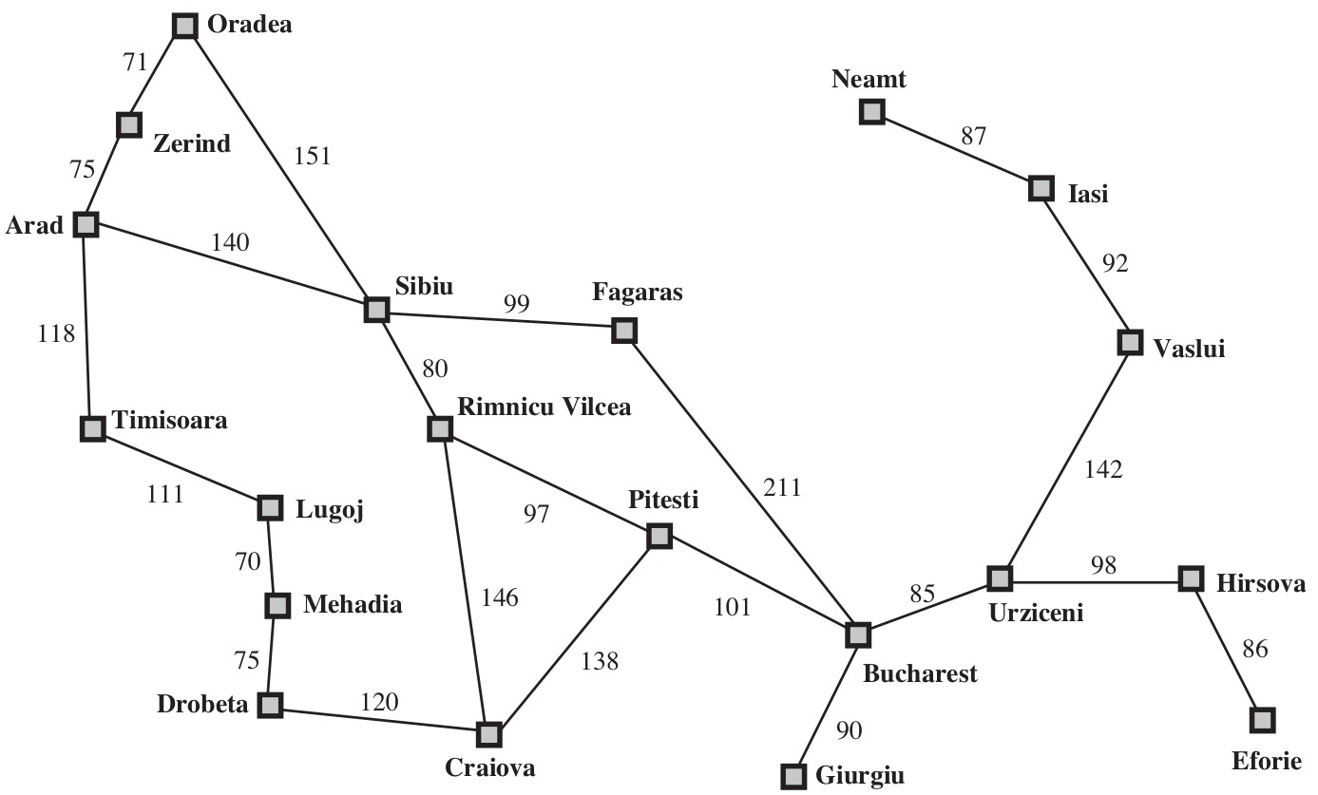
Problem Solving as Search: Example [cont.]
A simplified road map of part of Romania.
(Oc S. Russell & P. Norwig, AIMA)

Slide 14
Problem Solving as Search [cont.]
Assumptions for Problem-solving Agents (this chapter only) state representations are atomic
=⇒ world states are considered as wholes, with no internal structure Ex: Arad, Sibiu, Zerind, Bucharest,...
the environment is observable
=⇒ the agent always knows the current state Ex: Romanian cities & roads have signs
the environment is discrete
=⇒ at any state there are only finitely many actions to choose from Ex: from Arad, (go to) Sibiu, or Zerind, or Timisoara (see map)
the environment is known
=⇒ the agent knows which states are reached by each action ex: the agent has the map
the environment is deterministic
=⇒ each action has exactly one outcome
Ex: from Arad choose go to Sibiu =⇒ next step in Sibiu

Slide 15
Problem Solving as Search [cont.]
Assumptions for Problem-solving Agents (this chapter only) state representations are atomic
=⇒ world states are considered as wholes, with no internal structure Ex: Arad, Sibiu, Zerind, Bucharest,...
the environment is observable
=⇒ the agent always knows the current state Ex: Romanian cities & roads have signs
the environment is discrete
=⇒ at any state there are only finitely many actions to choose from Ex: from Arad, (go to) Sibiu, or Zerind, or Timisoara (see map)
the environment is known
=⇒ the agent knows which states are reached by each action ex: the agent has the map
the environment is deterministic
=⇒ each action has exactly one outcome
Ex: from Arad choose go to Sibiu =⇒ next step in Sibiu
7 / 96

Slide 16
Problem Solving as Search [cont.]
Assumptions for Problem-solving Agents (this chapter only) state representations are atomic
=⇒ world states are considered as wholes, with no internal structure Ex: Arad, Sibiu, Zerind, Bucharest,...
the environment is observable
=⇒ the agent always knows the current state Ex: Romanian cities & roads have signs
the environment is discrete
=⇒ at any state there are only finitely many actions to choose from Ex: from Arad, (go to) Sibiu, or Zerind, or Timisoara (see map)
the environment is known
=⇒ the agent knows which states are reached by each action ex: the agent has the map
the environment is deterministic
=⇒ each action has exactly one outcome
Ex: from Arad choose go to Sibiu =⇒ next step in Sibiu
7 / 96

Slide 17
Problem Solving as Search [cont.]
Assumptions for Problem-solving Agents (this chapter only) state representations are atomic
=⇒ world states are considered as wholes, with no internal structure Ex: Arad, Sibiu, Zerind, Bucharest,...
the environment is observable
=⇒ the agent always knows the current state Ex: Romanian cities & roads have signs
the environment is discrete
=⇒ at any state there are only finitely many actions to choose from Ex: from Arad, (go to) Sibiu, or Zerind, or Timisoara (see map)
the environment is known
=⇒ the agent knows which states are reached by each action ex: the agent has the map
the environment is deterministic
=⇒ each action has exactly one outcome
Ex: from Arad choose go to Sibiu =⇒ next step in Sibiu
7 / 96

Slide 18
Problem Solving as Search [cont.]
Assumptions for Problem-solving Agents (this chapter only) state representations are atomic
=⇒ world states are considered as wholes, with no internal structure Ex: Arad, Sibiu, Zerind, Bucharest,...
the environment is observable
=⇒ the agent always knows the current state Ex: Romanian cities & roads have signs
the environment is discrete
=⇒ at any state there are only finitely many actions to choose from Ex: from Arad, (go to) Sibiu, or Zerind, or Timisoara (see map)
the environment is known
=⇒ the agent knows which states are reached by each action ex: the agent has the map
the environment is deterministic
=⇒ each action has exactly one outcome
Ex: from Arad choose go to Sibiu =⇒ next step in Sibiu
7 / 96

Slide 19
Problem Solving as Search [cont.]
Assumptions for Problem-solving Agents (this chapter only) state representations are atomic
=⇒ world states are considered as wholes, with no internal structure Ex: Arad, Sibiu, Zerind, Bucharest,...
the environment is observable
=⇒ the agent always knows the current state Ex: Romanian cities & roads have signs
the environment is discrete
=⇒ at any state there are only finitely many actions to choose from Ex: from Arad, (go to) Sibiu, or Zerind, or Timisoara (see map)
the environment is known
=⇒ the agent knows which states are reached by each action ex: the agent has the map
the environment is deterministic
=⇒ each action has exactly one outcome
Ex: from Arad choose go to Sibiu =⇒ next step in Sibiu

Slide 20
Problem Solving as Search [cont.]
Notes about search
Search happens inside the agent
a planning stage before acting different from searching in the world
An agent is given a description of what to achieve, not an algorithm to solve it
=⇒ the only possibility is to search for a solution
Searching can be computationally very demanding (NP-hard)
Can be driven with benefits by knowledge of the problem (heuristic knowledge) =⇒ informed/heuristic search
8 / 96

Slide 21
Problem Solving as Search [cont.]
Notes about search
Search happens inside the agent
a planning stage before acting different from searching in the world
An agent is given a description of what to achieve, not an algorithm to solve it
=⇒ the only possibility is to search for a solution
Searching can be computationally very demanding (NP-hard)
Can be driven with benefits by knowledge of the problem (heuristic knowledge) =⇒ informed/heuristic search
8 / 96

Slide 22
Problem Solving as Search [cont.]
Notes about search
Search happens inside the agent
a planning stage before acting different from searching in the world
An agent is given a description of what to achieve, not an algorithm to solve it
=⇒ the only possibility is to search for a solution
Searching can be computationally very demanding (NP-hard)
Can be driven with benefits by knowledge of the problem (heuristic knowledge) =⇒ informed/heuristic search
8 / 96

Slide 23
Problem Solving as Search [cont.]
Notes about search
Search happens inside the agent
a planning stage before acting different from searching in the world
An agent is given a description of what to achieve, not an algorithm to solve it
=⇒ the only possibility is to search for a solution
Searching can be computationally very demanding (NP-hard)
Can be driven with benefits by knowledge of the problem (heuristic knowledge) =⇒ informed/heuristic search
8 / 96

Slide 24
Problem Solving as Search [cont.]
Notes about search
Search happens inside the agent
a planning stage before acting different from searching in the world
An agent is given a description of what to achieve, not an algorithm to solve it
=⇒ the only possibility is to search for a solution
Searching can be computationally very demanding (NP-hard)
Can be driven with benefits by knowledge of the problem (heuristic knowledge) =⇒ informed/heuristic search
8 / 96

Slide 25
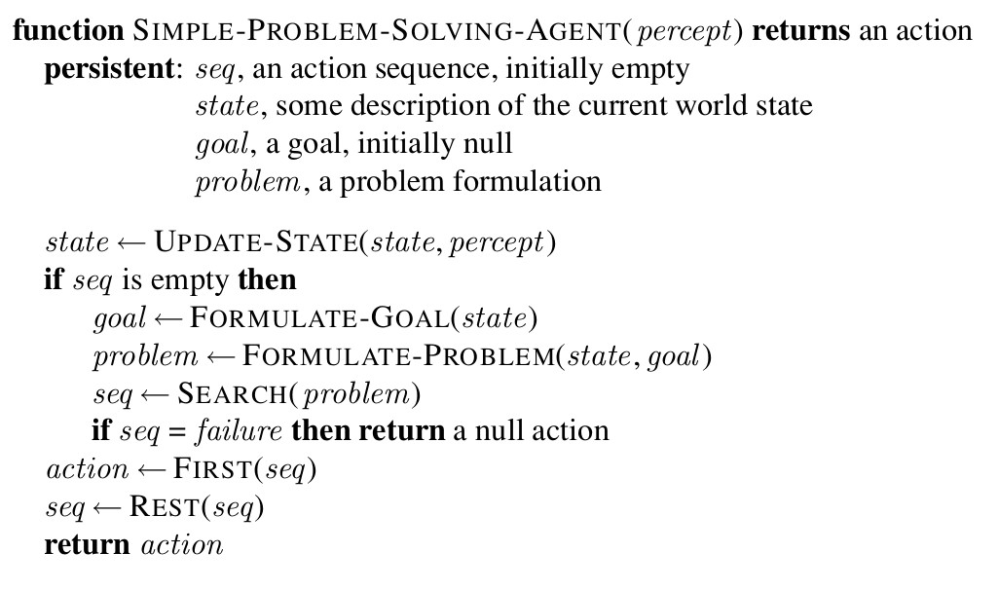
Problem-solving Agent: Schema
(Oc S. Russell & P. Norwig, AIMA)
While executing the solution sequence the agent ignores its percepts when choosing an action since it knows in advance what they will be
(“open loop system”)
9 / 96

Slide 26
Problem-solving Agent: Schema
(Oc S. Russell & P. Norwig, AIMA)
While executing the solution sequence the agent ignores its percepts when choosing an action since it knows in advance what they will be
(“open loop system”)
9 / 96

Slide 27
Well-defined problems and solutions
Problem Formulation: Components the initial state the agent starts in
Ex: In(Arad )
the set of applicable actions available in a state (ACTIONS(S))
Ex: if s is In(Arad ), then the applicable actions are
{Go(Sibiu), Go(Timisoara), Go(Zerind )}
a description of what each action does (aka transition model) RESULT(S,A): state resulting from applying action A in state S Ex: RESULT(IN(ARAD), GO(ZERIND)) is IN(ZERIND)
the goal test determining if a given state is a goal state
Explicit (e.g.: {In(Bucharest )}) Implicit (e.g. (Ex: CHECKMATE(X))
the path cost function assigns a numeric cost to each path
in this chapter: the sum of the costs of the actions along the path
10 / 96

Slide 28
Well-defined problems and solutions
Problem Formulation: Components the initial state the agent starts in
Ex: In(Arad )
the set of applicable actions available in a state (ACTIONS(S))
Ex: if s is In(Arad ), then the applicable actions are
{Go(Sibiu), Go(Timisoara), Go(Zerind )}
a description of what each action does (aka transition model) RESULT(S,A): state resulting from applying action A in state S Ex: RESULT(IN(ARAD), GO(ZERIND)) is IN(ZERIND)
the goal test determining if a given state is a goal state
Explicit (e.g.: {In(Bucharest )}) Implicit (e.g. (Ex: CHECKMATE(X))
the path cost function assigns a numeric cost to each path
in this chapter: the sum of the costs of the actions along the path
10 / 96

Slide 29
Well-defined problems and solutions
Problem Formulation: Components the initial state the agent starts in
Ex: In(Arad )
the set of applicable actions available in a state (ACTIONS(S))
Ex: if s is In(Arad ), then the applicable actions are
{Go(Sibiu), Go(Timisoara), Go(Zerind )}
a description of what each action does (aka transition model) RESULT(S,A): state resulting from applying action A in state S Ex: RESULT(IN(ARAD), GO(ZERIND)) is IN(ZERIND)
the goal test determining if a given state is a goal state
Explicit (e.g.: {In(Bucharest )}) Implicit (e.g. (Ex: CHECKMATE(X))
the path cost function assigns a numeric cost to each path
in this chapter: the sum of the costs of the actions along the path
10 / 96

Slide 30
Well-defined problems and solutions
Problem Formulation: Components the initial state the agent starts in
Ex: In(Arad )
the set of applicable actions available in a state (ACTIONS(S))
Ex: if s is In(Arad ), then the applicable actions are
{Go(Sibiu), Go(Timisoara), Go(Zerind )}
a description of what each action does (aka transition model) RESULT(S,A): state resulting from applying action A in state S Ex: RESULT(IN(ARAD), GO(ZERIND)) is IN(ZERIND)
the goal test determining if a given state is a goal state
Explicit (e.g.: {In(Bucharest )}) Implicit (e.g. (Ex: CHECKMATE(X))
the path cost function assigns a numeric cost to each path
in this chapter: the sum of the costs of the actions along the path
10 / 96

Slide 31
Well-defined problems and solutions
Problem Formulation: Components the initial state the agent starts in
Ex: In(Arad )
the set of applicable actions available in a state (ACTIONS(S))
Ex: if s is In(Arad ), then the applicable actions are
{Go(Sibiu), Go(Timisoara), Go(Zerind )}
a description of what each action does (aka transition model) RESULT(S,A): state resulting from applying action A in state S Ex: RESULT(IN(ARAD), GO(ZERIND)) is IN(ZERIND)
the goal test determining if a given state is a goal state
Explicit (e.g.: {In(Bucharest )}) Implicit (e.g. (Ex: CHECKMATE(X))
the path cost function assigns a numeric cost to each path
in this chapter: the sum of the costs of the actions along the path
10 / 96

Slide 32
Well-defined problems and solutions
Problem Formulation: Components the initial state the agent starts in
Ex: In(Arad )
the set of applicable actions available in a state (ACTIONS(S))
Ex: if s is In(Arad ), then the applicable actions are
{Go(Sibiu), Go(Timisoara), Go(Zerind )}
a description of what each action does (aka transition model) RESULT(S,A): state resulting from applying action A in state S Ex: RESULT(IN(ARAD), GO(ZERIND)) is IN(ZERIND)
the goal test determining if a given state is a goal state
Explicit (e.g.: {In(Bucharest )}) Implicit (e.g. (Ex: CHECKMATE(X))
the path cost function assigns a numeric cost to each path
in this chapter: the sum of the costs of the actions along the path

Slide 33
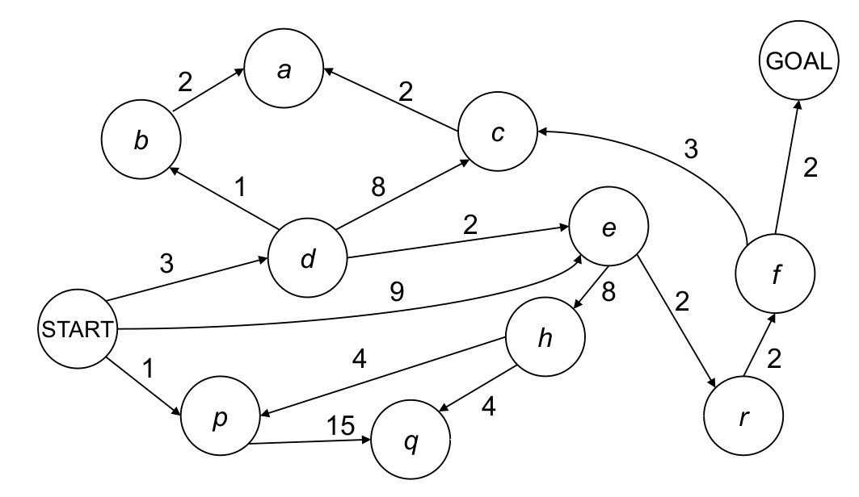
Well-defined problems and solutions [cont.]
State Space, Graphs, Paths, Solutions and Optimal Solutions
Initial state, actions, and transition model implicitly define the state space of the problem
the state space forms a directed graph (e.g. the Romania map)
typically too big to be created explicitly and be stored in full in a state space graph, each state occurs only once
a path is a sequence of states connected by actions
a solution is a path from the initial state to a goal state an optimal solution is a solution with the lowest path cost
(Oc D. Klein, P. Abbeel, S. Levine, S. Russell, U. Berkeley)
11 / 96

Slide 34
Well-defined problems and solutions [cont.]
State Space, Graphs, Paths, Solutions and Optimal Solutions
Initial state, actions, and transition model implicitly define the state space of the problem
the state space forms a directed graph (e.g. the Romania map)
typically too big to be created explicitly and be stored in full in a state space graph, each state occurs only once
a path is a sequence of states connected by actions
a solution is a path from the initial state to a goal state an optimal solution is a solution with the lowest path cost
(Oc D. Klein, P. Abbeel, S. Levine, S. Russell, U. Berkeley)
11 / 96

Slide 35
Well-defined problems and solutions [cont.]
State Space, Graphs, Paths, Solutions and Optimal Solutions
Initial state, actions, and transition model implicitly define the state space of the problem
the state space forms a directed graph (e.g. the Romania map)
typically too big to be created explicitly and be stored in full in a state space graph, each state occurs only once
a path is a sequence of states connected by actions
a solution is a path from the initial state to a goal state an optimal solution is a solution with the lowest path cost
(Oc D. Klein, P. Abbeel, S. Levine, S. Russell, U. Berkeley)
11 / 96

Slide 36
Well-defined problems and solutions [cont.]
State Space, Graphs, Paths, Solutions and Optimal Solutions
Initial state, actions, and transition model implicitly define the state space of the problem
the state space forms a directed graph (e.g. the Romania map)
typically too big to be created explicitly and be stored in full in a state space graph, each state occurs only once
a path is a sequence of states connected by actions
a solution is a path from the initial state to a goal state an optimal solution is a solution with the lowest path cost
(Oc D. Klein, P. Abbeel, S. Levine, S. Russell, U. Berkeley)
11 / 96

Slide 37
Well-defined problems and solutions [cont.]
State Space, Graphs, Paths, Solutions and Optimal Solutions
Initial state, actions, and transition model implicitly define the state space of the problem
the state space forms a directed graph (e.g. the Romania map)
typically too big to be created explicitly and be stored in full in a state space graph, each state occurs only once
a path is a sequence of states connected by actions
a solution is a path from the initial state to a goal state an optimal solution is a solution with the lowest path cost
(Oc D. Klein, P. Abbeel, S. Levine, S. Russell, U. Berkeley)
11 / 96

Slide 38
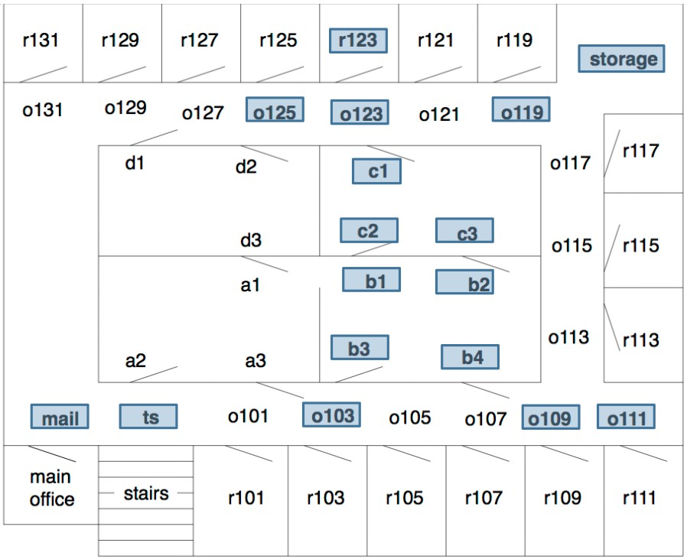
Example: Path finding for a Delivery Robot
Task: move from o103 to r123
States Initial state Goal state State graph
Optimal solution
(Courtesy of Maria Simi, UniPI)
12 / 96

Slide 39
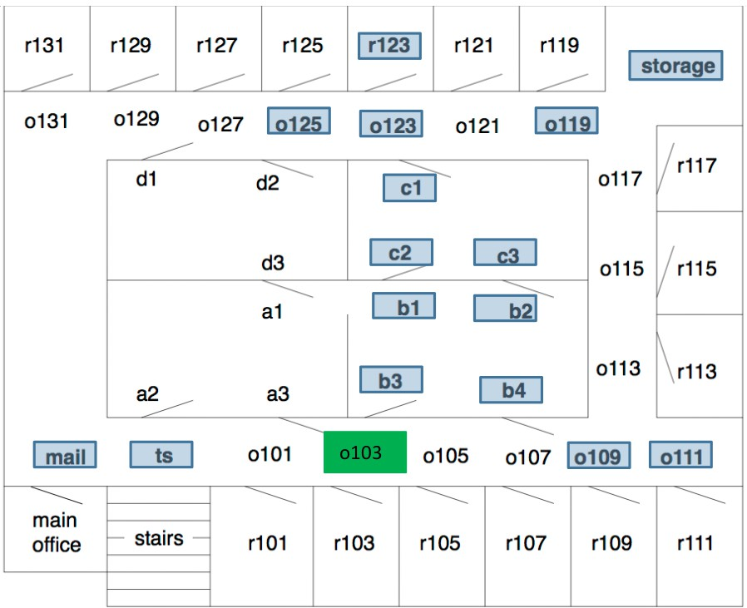
Example: Path finding for a Delivery Robot
Task: move from o103 to r123
States Initial state Goal state State graph
Optimal solution
(Courtesy of Maria Simi, UniPI)
12 / 96

Slide 40
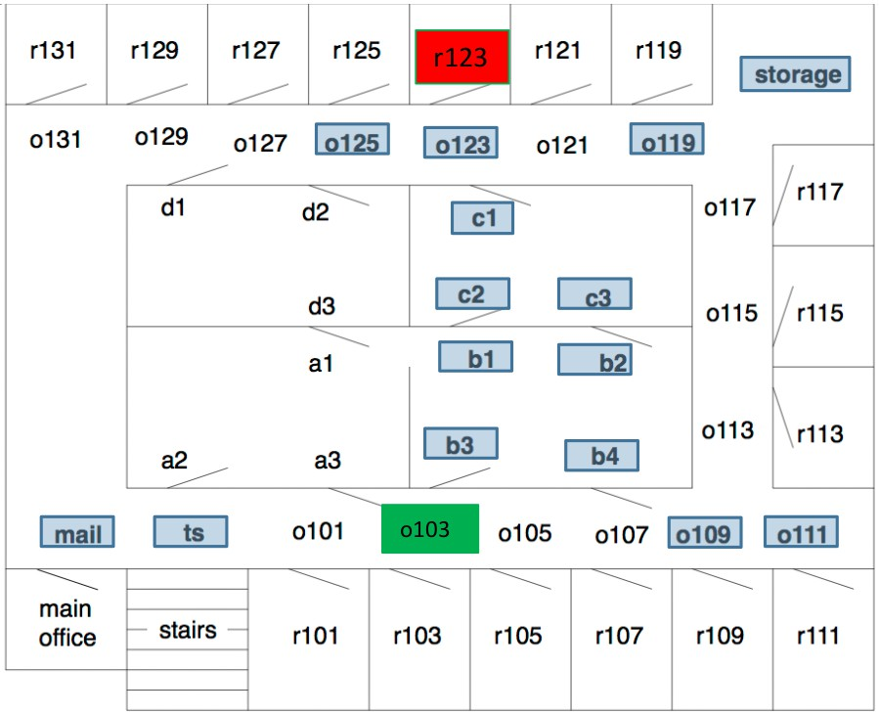
Example: Path finding for a Delivery Robot
Task: move from o103 to r123
States Initial state Goal state State graph
Optimal solution
(Courtesy of Maria Simi, UniPI)
12 / 96

Slide 41
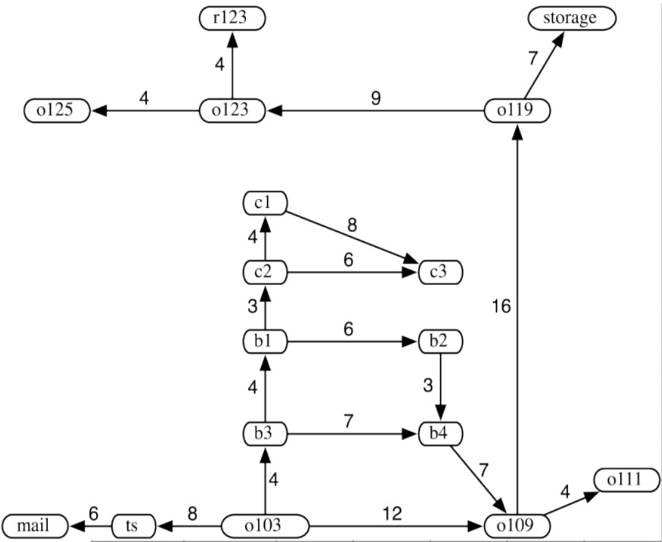
Example: Path finding for a Delivery Robot
Task: move from o103 to r123
States Initial state Goal state State graph
Optimal solution
(Courtesy of Maria Simi, UniPI)
12 / 96

Slide 42
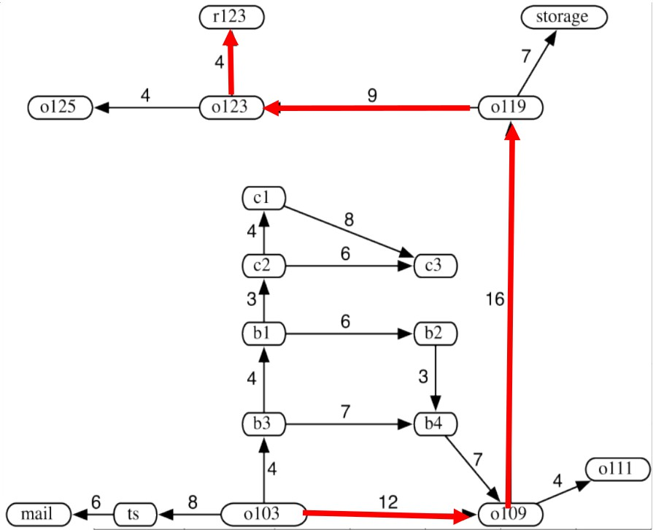
Example: Path finding for a Delivery Robot
Task: move from o103 to r123
States Initial state Goal state State graph
Optimal solution
(Courtesy of Maria Simi, UniPI)
12 / 96

Slide 43
Well-defined problems and solutions [cont.]
Abstraction
Problem formulations are models of reality (i.e. abstract descriptions) real world is absurdly complex
=⇒ state space must be abstracted for problem solving
lots of details removed because irrelevant to the problem
Ex: exact position, “turn steering wheel to the left by 20 degree”, ...
abstraction: the process of removing detail from representations
abstract state represents many real states
abstract action represents complex combination of real actions
valid abstraction: can expand any abstract solution into a solution in the detailed world
useful abstraction: if carrying out each of the actions in the solution is easier than in the original problem
The choice of a good abstraction involves removing as much detail as possible, while retaining validity and ensuring that the abstract actions are easy to carry out.
13 / 96

Slide 44
Well-defined problems and solutions [cont.]
Abstraction
Problem formulations are models of reality (i.e. abstract descriptions) real world is absurdly complex
=⇒ state space must be abstracted for problem solving
lots of details removed because irrelevant to the problem
Ex: exact position, “turn steering wheel to the left by 20 degree”, ...
abstraction: the process of removing detail from representations
abstract state represents many real states
abstract action represents complex combination of real actions
valid abstraction: can expand any abstract solution into a solution in the detailed world
useful abstraction: if carrying out each of the actions in the solution is easier than in the original problem
The choice of a good abstraction involves removing as much detail as possible, while retaining validity and ensuring that the abstract actions are easy to carry out.
13 / 96

Slide 45
Well-defined problems and solutions [cont.]
Abstraction
Problem formulations are models of reality (i.e. abstract descriptions) real world is absurdly complex
=⇒ state space must be abstracted for problem solving
lots of details removed because irrelevant to the problem
Ex: exact position, “turn steering wheel to the left by 20 degree”, ...
abstraction: the process of removing detail from representations
abstract state represents many real states
abstract action represents complex combination of real actions
valid abstraction: can expand any abstract solution into a solution in the detailed world
useful abstraction: if carrying out each of the actions in the solution is easier than in the original problem
The choice of a good abstraction involves removing as much detail as possible, while retaining validity and ensuring that the abstract actions are easy to carry out.
13 / 96

Slide 46
Well-defined problems and solutions [cont.]
Abstraction
Problem formulations are models of reality (i.e. abstract descriptions) real world is absurdly complex
=⇒ state space must be abstracted for problem solving
lots of details removed because irrelevant to the problem
Ex: exact position, “turn steering wheel to the left by 20 degree”, ...
abstraction: the process of removing detail from representations
abstract state represents many real states
abstract action represents complex combination of real actions
valid abstraction: can expand any abstract solution into a solution in the detailed world
useful abstraction: if carrying out each of the actions in the solution is easier than in the original problem
The choice of a good abstraction involves removing as much detail as possible, while retaining validity and ensuring that the abstract actions are easy to carry out.
13 / 96

Slide 47
Well-defined problems and solutions [cont.]
Abstraction
Problem formulations are models of reality (i.e. abstract descriptions) real world is absurdly complex
=⇒ state space must be abstracted for problem solving
lots of details removed because irrelevant to the problem
Ex: exact position, “turn steering wheel to the left by 20 degree”, ...
abstraction: the process of removing detail from representations
abstract state represents many real states
abstract action represents complex combination of real actions
valid abstraction: can expand any abstract solution into a solution in the detailed world
useful abstraction: if carrying out each of the actions in the solution is easier than in the original problem
The choice of a good abstraction involves removing as much detail as possible, while retaining validity and ensuring that the abstract actions are easy to carry out.
13 / 96

Slide 48
Well-defined problems and solutions [cont.]
Abstraction
Problem formulations are models of reality (i.e. abstract descriptions) real world is absurdly complex
=⇒ state space must be abstracted for problem solving
lots of details removed because irrelevant to the problem
Ex: exact position, “turn steering wheel to the left by 20 degree”, ...
abstraction: the process of removing detail from representations
abstract state represents many real states
abstract action represents complex combination of real actions
valid abstraction: can expand any abstract solution into a solution in the detailed world
useful abstraction: if carrying out each of the actions in the solution is easier than in the original problem
The choice of a good abstraction involves removing as much detail as possible, while retaining validity and ensuring that the abstract actions are easy to carry out.
13 / 96

Slide 49
Well-defined problems and solutions [cont.]
Abstraction
Problem formulations are models of reality (i.e. abstract descriptions) real world is absurdly complex
=⇒ state space must be abstracted for problem solving
lots of details removed because irrelevant to the problem
Ex: exact position, “turn steering wheel to the left by 20 degree”, ...
abstraction: the process of removing detail from representations
abstract state represents many real states
abstract action represents complex combination of real actions
valid abstraction: can expand any abstract solution into a solution in the detailed world
useful abstraction: if carrying out each of the actions in the solution is easier than in the original problem
The choice of a good abstraction involves removing as much detail as possible, while retaining validity and ensuring that the abstract actions are easy to carry out.

Slide 50

Outline
1
Problem-Solving Agents
Example Problems Search Generalities
Uninformed Search Strategies Breadth-First Search Uniform-cost Search
Depth-First Search
Depth-Limited Search & Iterative Deepening
Informed Search Strategies Greedy Search
A∗ Search Heuristic Functions
2
3
4
5

Slide 51
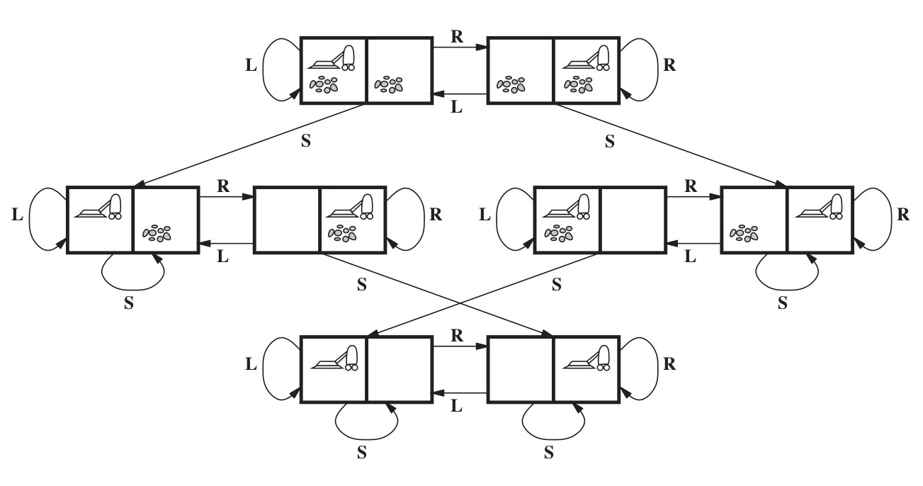
Toy Example: Simple Vacuum Cleaner
States: 2 locations, each {clean, dirty}: 2 · 2² = 8 states Initial State: any
Actions: {Left, Right, Suck}
Transition Model: Left [Right] if A [B], Suck if clean =⇒ no effect Goal Test: check if squares are clean
Path Cost: each step costs 1 =⇒ path cost is # of steps in path
(Oc S. Russell & P. Norwig, AIMA)

Slide 52
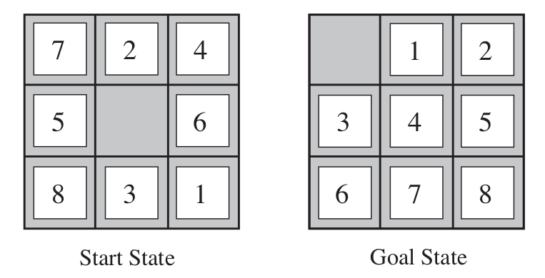
Toy Example: The 8-Puzzle
States: Integer location of each tile =⇒ 9!/2 reachable states Initial State: any
Actions: moving {Left, Right, Up, Down} the empty space Transition Model: empty switched with the tile in target location Goal Test: checks state corresponds with goal configuration Path Cost: each step costs 1 =⇒ path cost is # of steps in path
(Oc S. Russell & P. Norwig, AIMA)

Slide 53
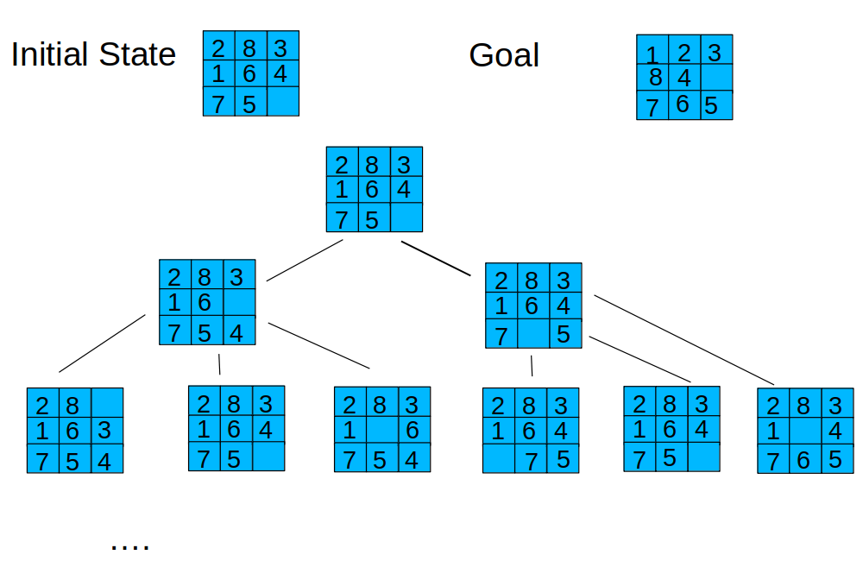
Toy Example: The 8-Puzzle [cont.]
(Courtesy of Michela Milano, UniBO)
NP-complete: N-Puzzle (N = k ² − 1): N!/2 reachable states

Slide 54
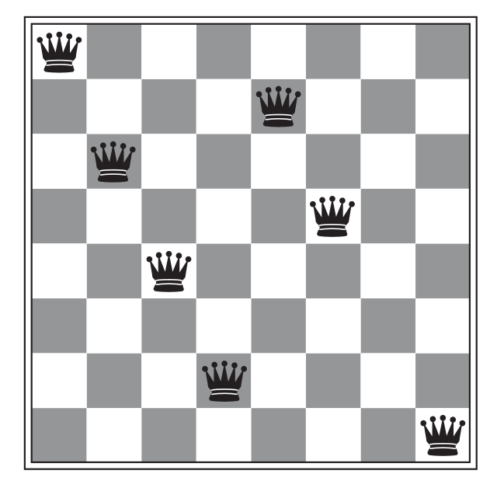
Toy Example: 8-Queens Problem
States: any arrangement of 0 to 8 queens on the board
=⇒ 64 · 63 · ... · 57 ≈ 1.8 · 10¹⁴ possible sequences
Initial State: no queens on the board Actions: add a queen to any empty square
Transition Model: returns the board with a queen added
Goal Test: 8 queens on the board, none attacked by other queen Path Cost: none
(Oc S. Russell & P. Norwig, AIMA)

Slide 55
Toy Example: 8-Queens Problem
States: any arrangement of 0 to 8 queens on the board
=⇒ 64 · 63 · ... · 57 ≈ 1.8 · 10¹⁴ possible sequences
Initial State: no queens on the board Actions: add a queen to any empty square
Transition Model: returns the board with a queen added
Goal Test: 8 queens on the board, none attacked by other queen Path Cost: none
(Oc S. Russell & P. Norwig, AIMA)

Slide 56
Toy Example: 8-Queens Problem (incremental)
States: n ≤ 8 queens on board, one per column in the n leftmost columns, no queen attacking another
=⇒ 2057 possible sequences
Actions: Add a queen to any square in the leftmost empty column such that it is not attacked by any other queen.
...
(Oc S. Russell & P. Norwig, AIMA)

Slide 57
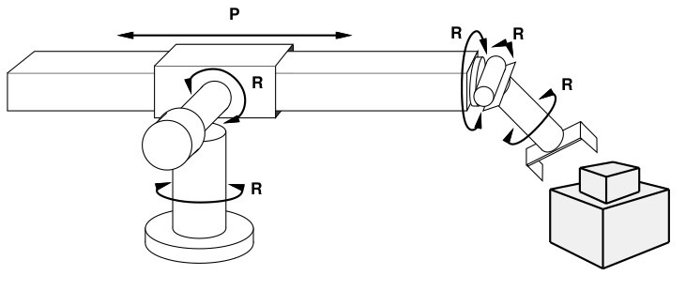
Real-World Example: Robotic Assembly
States: real-valued coordinates of robot joint angles, and of parts of the object to be assembled
Initial State: any arm position and object configuration Actions: continuous motions of robot joints
Transition Model: position resulting from motion Goal Test: complete assembly (without robot) Path Cost: time to execute
(Oc S. Russell & P. Norwig, AIMA)

Slide 58
Other Real-World Examples
Airline travel planning problems Touring problems
VLSI layout problem Robot navigation
Automatic assembly sequencing Protein design
...

Slide 59
Outline
1
Problem-Solving Agents
Example Problems Search Generalities
Uninformed Search Strategies Breadth-First Search Uniform-cost Search
Depth-First Search
Depth-Limited Search & Iterative Deepening
Informed Search Strategies Greedy Search
A∗ Search Heuristic Functions
2
3
4
5

Slide 60
Searching for Solutions
Search: Generate sequences of actions.
Expansion: one starts from a state, and applying the operators (or successor function) will generate new states
Search strategy: at each step, choose which state to expand.
Search Tree: It represents the expansion of all states starting from the initial state (the root of the tree)
The leaves of the tree represent either:
states to expand solutions
dead-ends

Slide 61
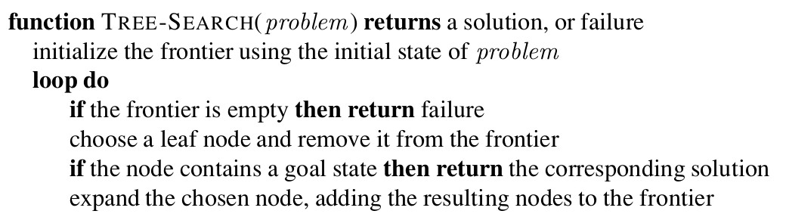
Tree Search Algorithms
Tree Search: Basic idea
Off-line, simulated exploration of state space
start from initial state
pick one leaf node, and generate its successors (a.k.a. expanding a node) states)
set of current leaves called frontier (a.k.a. fringe, open list) strategy for picking leaves critical (search strategy)
ends when either a goal state is reached, or no more candidates to expand are available (or time-out/memory-out occur)
(Oc S. Russell & P. Norwig, AIMA)

Slide 62
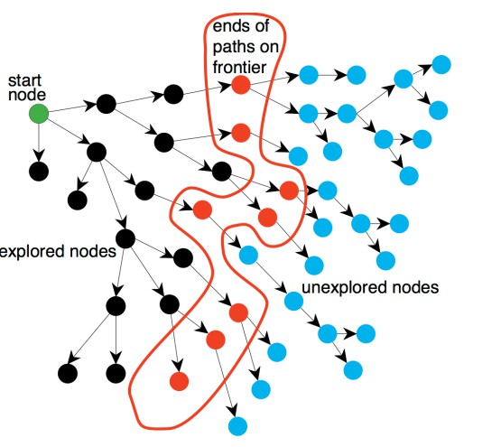
Tree Search Algorithms [cont.]
(Courtesy of Maria Simi, UniPI)

Slide 63
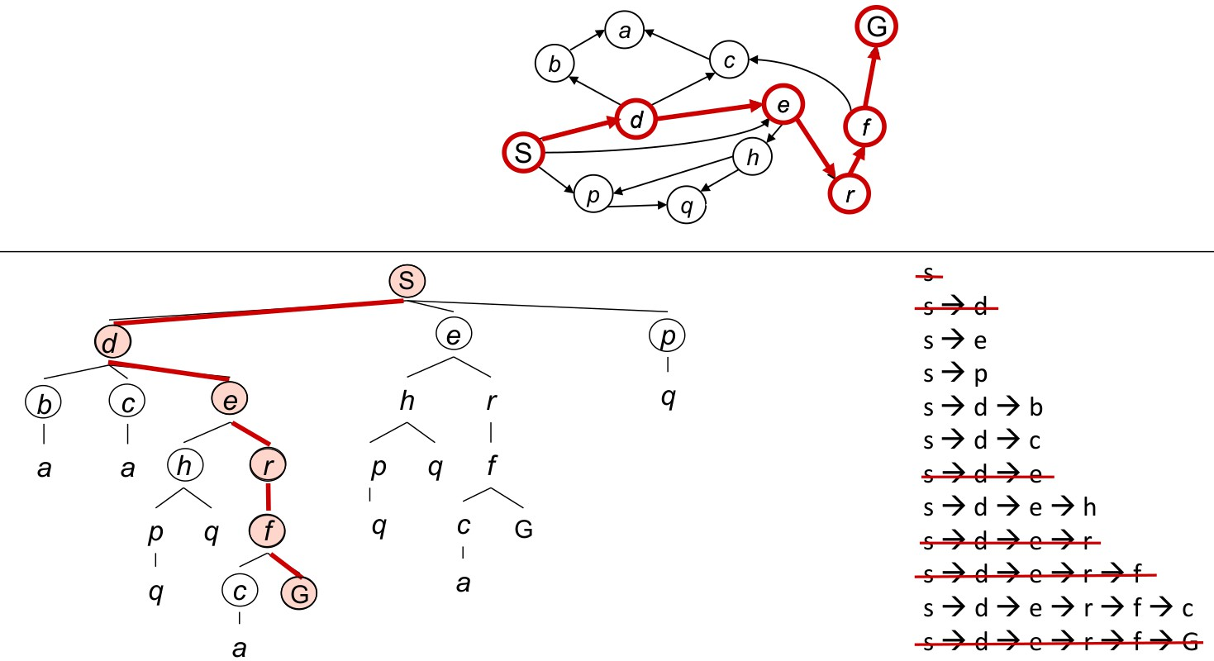
Tree-Search Example
(Oc D. Klein, P. Abbeel, S. Levine, S. Russell, U. Berkeley)

Slide 64
Tree-Search Example: Trip from Arad to Bucharest
A simplified road map of part of Romania.
(Oc S. Russell & P. Norwig, AIMA)

Slide 65
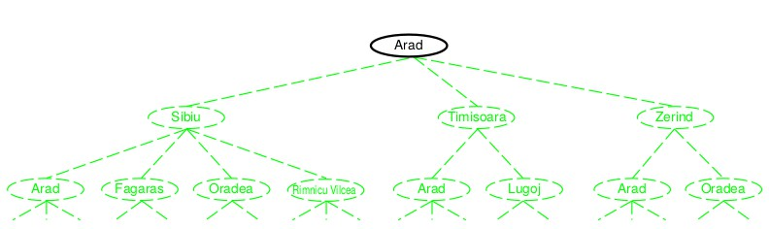
Tree-Search Example: Trip from Arad to Bucharest
Expanding the search tree Initial state: {Arad}
Expand initial state =⇒ {Sibiu, Timisoara, Zerind}
Pick&expand Sibiu =⇒ {Arad, Fagaras, Oradea, Rimnicu Vicea}
...
(Oc S. Russell & P. Norwig, AIMA)
Beware: Arad 1→ Sibiu 1→ Arad (repeated state =⇒ loopy path!)
29 / 96

Slide 66
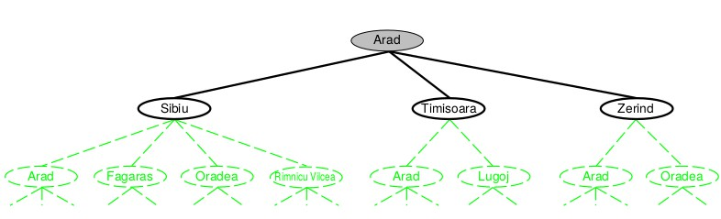
Tree-Search Example: Trip from Arad to Bucharest
Expanding the search tree Initial state: {Arad}
Expand initial state =⇒ {Sibiu, Timisoara, Zerind}
Pick&expand Sibiu =⇒ {Arad, Fagaras, Oradea, Rimnicu Vicea}
...
(Oc S. Russell & P. Norwig, AIMA)
Beware: Arad 1→ Sibiu 1→ Arad (repeated state =⇒ loopy path!)
29 / 96

Slide 67
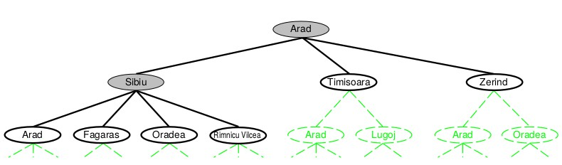
Tree-Search Example: Trip from Arad to Bucharest
Expanding the search tree Initial state: {Arad}
Expand initial state =⇒ {Sibiu, Timisoara, Zerind}
Pick&expand Sibiu =⇒ {Arad, Fagaras, Oradea, Rimnicu Vicea}
...
(Oc S. Russell & P. Norwig, AIMA)
Beware: Arad 1→ Sibiu 1→ Arad (repeated state =⇒ loopy path!)
29 / 96

Slide 68
Tree-Search Example: Trip from Arad to Bucharest
Expanding the search tree Initial state: {Arad}
Expand initial state =⇒ {Sibiu, Timisoara, Zerind}
Pick&expand Sibiu =⇒ {Arad, Fagaras, Oradea, Rimnicu Vicea}
...
(Oc S. Russell & P. Norwig, AIMA)
Beware: Arad 1→ Sibiu 1→ Arad (repeated state =⇒ loopy path!)
29 / 96

Slide 69
Tree-Search Example: Trip from Arad to Bucharest
Expanding the search tree Initial state: {Arad}
Expand initial state =⇒ {Sibiu, Timisoara, Zerind}
Pick&expand Sibiu =⇒ {Arad, Fagaras, Oradea, Rimnicu Vicea}
...
(Oc S. Russell & P. Norwig, AIMA)
Beware: Arad 1→ Sibiu 1→ Arad (repeated state =⇒ loopy path!)
29 / 96

Slide 70

Repeated states & Redundant Paths
redundant paths occur when there is more than one way to get from one state to another
=⇒ same state explored more than once
Failure to detect repeated states can:
cause infinite loops
turn linear problem into exponential
(Oc S. Russell & P. Norwig, AIMA)
Moral: Algorithms that forget their history are doomed to repe at it!
30 / 96

Slide 71
Repeated states & Redundant Paths
redundant paths occur when there is more than one way to get from one state to another
=⇒ same state explored more than once
Failure to detect repeated states can:
cause infinite loops
turn linear problem into exponential
(Oc S. Russell & P. Norwig, AIMA)
Moral: Algorithms that forget their history are doomed to repe at it!
30 / 96

Slide 72
Repeated states & Redundant Paths
redundant paths occur when there is more than one way to get from one state to another
=⇒ same state explored more than once
Failure to detect repeated states can:
cause infinite loops
turn linear problem into exponential
(Oc S. Russell & P. Norwig, AIMA)
Moral: Algorithms that forget their history are doomed to repe at it!
30 / 96

Slide 73
Repeated states & Redundant Paths
redundant paths occur when there is more than one way to get from one state to another
=⇒ same state explored more than once
Failure to detect repeated states can:
cause infinite loops
turn linear problem into exponential
(Oc S. Russell & P. Norwig, AIMA)
Moral: Algorithms that forget their history are doomed to repe at it!
30 / 96

Slide 74
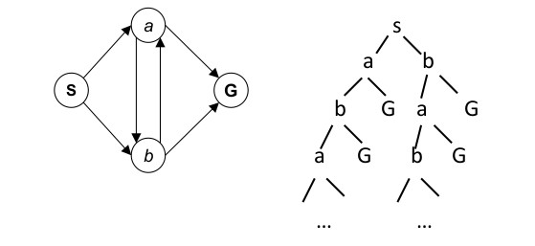
Repeated states & Redundant Paths
redundant paths occur when there is more than one way to get from one state to another
=⇒ same state explored more than once
Failure to detect repeated states can:
cause infinite loops
turn linear problem into exponential
(Oc S. Russell & P. Norwig, AIMA)
Moral: Algorithms that forget their history are doomed to repe at it!
30 / 96

Slide 75
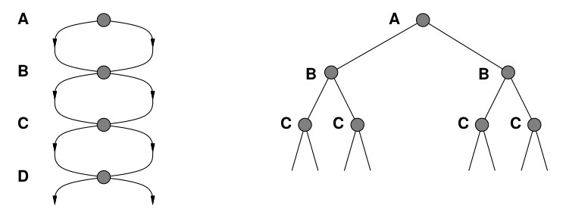
Repeated states & Redundant Paths
redundant paths occur when there is more than one way to get from one state to another
=⇒ same state explored more than once
Failure to detect repeated states can:
cause infinite loops
turn linear problem into exponential
(Oc S. Russell & P. Norwig, AIMA)
Moral: Algorithms that forget their history are doomed to repe at it!
30 / 96

Slide 76
Repeated states & Redundant Paths
redundant paths occur when there is more than one way to get from one state to another
=⇒ same state explored more than once
Failure to detect repeated states can:
cause infinite loops
turn linear problem into exponential
(Oc S. Russell & P. Norwig, AIMA)
Moral: Algorithms that forget their history are doomed to repeat it!
30 / 96

Slide 77
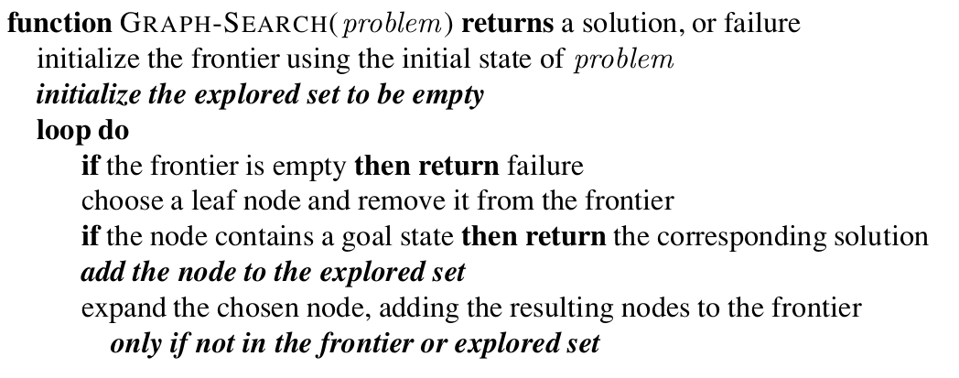
Graph Search Algorithms
Graph Search: Basic idea
add a data structure which remembers every expanded node
a.k.a. explored set or closed list typically a hash table (access O(1))
do not expand a node if it already occurs in explored set
(Oc S. Russell & P. Norwig, AIMA)

Slide 78
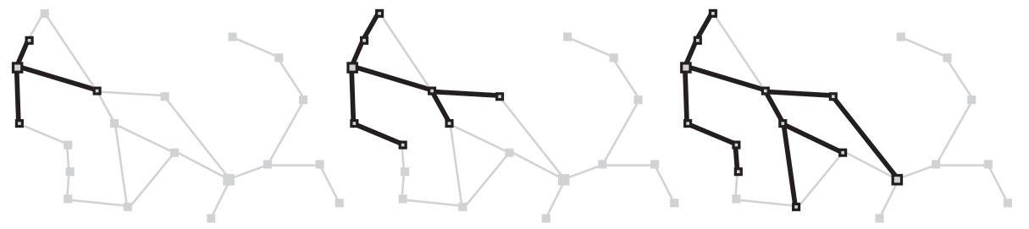
Graph Search Algorithms: Example
Graph search on the Romania trip problem
(at each stage each path extended by one step) two states become dead-end
(Oc S. Russell & P. Norwig, AIMA)

Slide 79
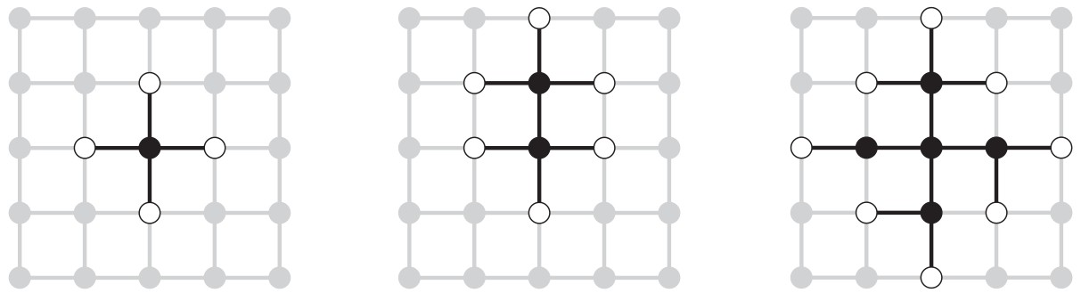
Graph Search Algorithms: Example
Separation Property of graph search: the frontier separates the
state-space graph into the explored region and the unexplored region
Graph search on a rectangular-grid problem
(Oc S. Russell & P. Norwig, AIMA)

Slide 80
Implementation: States vs. Nodes
A state is a representation of a physical configuration
A node is a data structure constituting part of a search tree
includes fields: state, parent, action, path cost g(x )
=⇒ node /= state
It is easy to compute a child node from its parent
(Oc S. Russell & P. Norwig, AIMA)
34 / 96

Slide 81
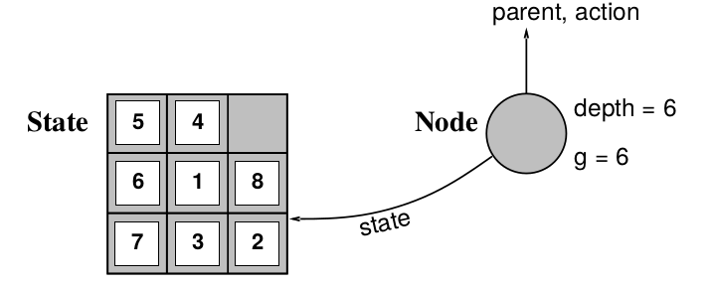
Implementation: States vs. Nodes
A state is a representation of a physical configuration
A node is a data structure constituting part of a search tree
includes fields: state, parent, action, path cost g(x )
=⇒ node /= state
It is easy to compute a child node from its parent
(Oc S. Russell & P. Norwig, AIMA)
34 / 96

Slide 82
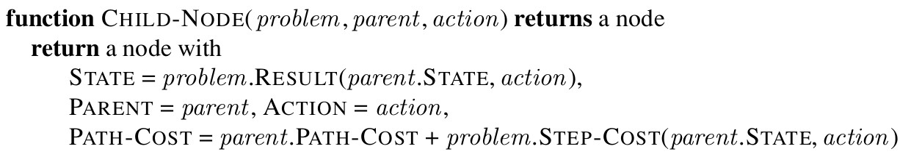
Implementation: States vs. Nodes
A state is a representation of a physical configuration
A node is a data structure constituting part of a search tree
includes fields: state, parent, action, path cost g(x )
=⇒ node /= state
It is easy to compute a child node from its parent
(Oc S. Russell & P. Norwig, AIMA)
34 / 96

Slide 83
Implementation: Frontier and Explored
Frontier/Fringe
Implemented as a Queue:
First-in-First-Out, FIFO (aka “queue”): O(1) access Last-in-First-Out, LIFO (aka “stack”): O(1) access Best-First-out (aka “priority queue”): O(log(n)) access
Two primitives:
ISEMPTY(QUEUE): returns true iff there are no more elements POP(QUEUE): removes and returns the first element of the queue INSERT(ELEMENT,QUEUE): inserts an element into queue
Explored
Implemented as a Hash Table: O(1) access Three primitives:
ISTHERE(ELEMENT,HASH): returns true iff element is in the hash INSERT(ELEMENT,HASH): inserts element into hash
Choice of hash function critical for efficiency
35 / 96

Slide 84
Implementation: Frontier and Explored
Frontier/Fringe
Implemented as a Queue:
First-in-First-Out, FIFO (aka “queue”): O(1) access Last-in-First-Out, LIFO (aka “stack”): O(1) access Best-First-out (aka “priority queue”): O(log(n)) access
Two primitives:
ISEMPTY(QUEUE): returns true iff there are no more elements POP(QUEUE): removes and returns the first element of the queue INSERT(ELEMENT,QUEUE): inserts an element into queue
Explored
Implemented as a Hash Table: O(1) access Three primitives:
ISTHERE(ELEMENT,HASH): returns true iff element is in the hash INSERT(ELEMENT,HASH): inserts element into hash
Choice of hash function critical for efficiency
35 / 96

Slide 85
Implementation: Frontier and Explored
Frontier/Fringe
Implemented as a Queue:
First-in-First-Out, FIFO (aka “queue”): O(1) access Last-in-First-Out, LIFO (aka “stack”): O(1) access Best-First-out (aka “priority queue”): O(log(n)) access
Two primitives:
ISEMPTY(QUEUE): returns true iff there are no more elements POP(QUEUE): removes and returns the first element of the queue INSERT(ELEMENT,QUEUE): inserts an element into queue
Explored
Implemented as a Hash Table: O(1) access Three primitives:
ISTHERE(ELEMENT,HASH): returns true iff element is in the hash INSERT(ELEMENT,HASH): inserts element into hash
Choice of hash function critical for efficiency
35 / 96

Slide 86
Implementation: Frontier and Explored
Frontier/Fringe
Implemented as a Queue:
First-in-First-Out, FIFO (aka “queue”): O(1) access Last-in-First-Out, LIFO (aka “stack”): O(1) access Best-First-out (aka “priority queue”): O(log(n)) access
Two primitives:
ISEMPTY(QUEUE): returns true iff there are no more elements POP(QUEUE): removes and returns the first element of the queue INSERT(ELEMENT,QUEUE): inserts an element into queue
Explored
Implemented as a Hash Table: O(1) access Three primitives:
ISTHERE(ELEMENT,HASH): returns true iff element is in the hash INSERT(ELEMENT,HASH): inserts element into hash
Choice of hash function critical for efficiency
35 / 96

Slide 87
Implementation: Frontier and Explored
Frontier/Fringe
Implemented as a Queue:
First-in-First-Out, FIFO (aka “queue”): O(1) access Last-in-First-Out, LIFO (aka “stack”): O(1) access Best-First-out (aka “priority queue”): O(log(n)) access
Two primitives:
ISEMPTY(QUEUE): returns true iff there are no more elements POP(QUEUE): removes and returns the first element of the queue INSERT(ELEMENT,QUEUE): inserts an element into queue
Explored
Implemented as a Hash Table: O(1) access Three primitives:
ISTHERE(ELEMENT,HASH): returns true iff element is in the hash INSERT(ELEMENT,HASH): inserts element into hash
Choice of hash function critical for efficiency
35 / 96

Slide 88
Implementation: Frontier and Explored
Frontier/Fringe
Implemented as a Queue:
First-in-First-Out, FIFO (aka “queue”): O(1) access Last-in-First-Out, LIFO (aka “stack”): O(1) access Best-First-out (aka “priority queue”): O(log(n)) access
Two primitives:
ISEMPTY(QUEUE): returns true iff there are no more elements POP(QUEUE): removes and returns the first element of the queue INSERT(ELEMENT,QUEUE): inserts an element into queue
Explored
Implemented as a Hash Table: O(1) access Three primitives:
ISTHERE(ELEMENT,HASH): returns true iff element is in the hash INSERT(ELEMENT,HASH): inserts element into hash
Choice of hash function critical for efficiency
35 / 96

Slide 89
Implementation: Frontier and Explored
Frontier/Fringe
Implemented as a Queue:
First-in-First-Out, FIFO (aka “queue”): O(1) access Last-in-First-Out, LIFO (aka “stack”): O(1) access Best-First-out (aka “priority queue”): O(log(n)) access
Two primitives:
ISEMPTY(QUEUE): returns true iff there are no more elements POP(QUEUE): removes and returns the first element of the queue INSERT(ELEMENT,QUEUE): inserts an element into queue
Explored
Implemented as a Hash Table: O(1) access Three primitives:
ISTHERE(ELEMENT,HASH): returns true iff element is in the hash INSERT(ELEMENT,HASH): inserts element into hash
Choice of hash function critical for efficiency

Slide 90
Uninformed vs. Informed Search Strategies
Strategies: Two possibilities
Uninformed strategies (a.k.a. blind strategies)
do not use any domain knowledge
apply rules arbitrarily and do an exhaustive search strategy
=⇒ impractical for some complex problems.
Informed strategies
use domain knowledge
apply rules following heuristics (driven by domain knowledge)
=⇒ practical for many complex problems.
36 / 96

Slide 91
Uninformed vs. Informed Search Strategies
Strategies: Two possibilities
Uninformed strategies (a.k.a. blind strategies)
do not use any domain knowledge
apply rules arbitrarily and do an exhaustive search strategy
=⇒ impractical for some complex problems.
Informed strategies
use domain knowledge
apply rules following heuristics (driven by domain knowledge)
=⇒ practical for many complex problems.
36 / 96

Slide 92
Uninformed vs. Informed Search Strategies
Strategies: Two possibilities
Uninformed strategies (a.k.a. blind strategies)
do not use any domain knowledge
apply rules arbitrarily and do an exhaustive search strategy
=⇒ impractical for some complex problems.
Informed strategies
use domain knowledge
apply rules following heuristics (driven by domain knowledge)
=⇒ practical for many complex problems.
36 / 96

Slide 93
Outline
1
Problem-Solving Agents
Example Problems Search Generalities
Uninformed Search Strategies Breadth-First Search Uniform-cost Search
Depth-First Search
Depth-Limited Search & Iterative Deepening
Informed Search Strategies Greedy Search
A∗ Search Heuristic Functions
2
3
4
5

Slide 94
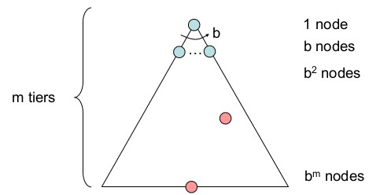
Evaluating Search Strategies
Strategies are evaluated along the following dimensions: completeness: does it always find a solution if one exists? time complexity: how many steps to find a solution?
space complexity: how much memory is needed? optimality: does it always find a least-cost solution?
Time and space complexity are measured in terms of
b: maximum branching factor of the search tree d: depth of the least-cost solution
m: maximum depth of the state space (may be +∞)
=⇒ # nodes: 1 + b + b² + ... + b^{m} = O(b^{m} )
(Oc D. Klein, P. Abbeel, S. Levine, S. Russell, U. Berkeley)
38 / 96

Slide 95
Evaluating Search Strategies
Strategies are evaluated along the following dimensions: completeness: does it always find a solution if one exists? time complexity: how many steps to find a solution?
space complexity: how much memory is needed? optimality: does it always find a least-cost solution?
Time and space complexity are measured in terms of
b: maximum branching factor of the search tree d: depth of the least-cost solution
m: maximum depth of the state space (may be +∞)
=⇒ # nodes: 1 + b + b² + ... + b^{m} = O(b^{m} )
(Oc D. Klein, P. Abbeel, S. Levine, S. Russell, U. Berkeley)
38 / 96

Slide 96
Evaluating Search Strategies
Strategies are evaluated along the following dimensions: completeness: does it always find a solution if one exists? time complexity: how many steps to find a solution?
space complexity: how much memory is needed? optimality: does it always find a least-cost solution?
Time and space complexity are measured in terms of
b: maximum branching factor of the search tree d: depth of the least-cost solution
m: maximum depth of the state space (may be +∞)
=⇒ # nodes: 1 + b + b² + ... + b^{m} = O(b^{m} )
(Oc D. Klein, P. Abbeel, S. Levine, S. Russell, U. Berkeley)
38 / 96

Slide 97
Evaluating Search Strategies
Strategies are evaluated along the following dimensions: completeness: does it always find a solution if one exists? time complexity: how many steps to find a solution?
space complexity: how much memory is needed? optimality: does it always find a least-cost solution?
Time and space complexity are measured in terms of
b: maximum branching factor of the search tree d: depth of the least-cost solution
m: maximum depth of the state space (may be +∞)
=⇒ # nodes: 1 + b + b² + ... + b^{m} = O(b^{m} )
(Oc D. Klein, P. Abbeel, S. Levine, S. Russell, U. Berkeley)
38 / 96

Slide 98
Evaluating Search Strategies
Strategies are evaluated along the following dimensions: completeness: does it always find a solution if one exists? time complexity: how many steps to find a solution?
space complexity: how much memory is needed? optimality: does it always find a least-cost solution?
Time and space complexity are measured in terms of
b: maximum branching factor of the search tree d: depth of the least-cost solution
m: maximum depth of the state space (may be +∞)
=⇒ # nodes: 1 + b + b² + ... + b^{m} = O(b^{m} )
(Oc D. Klein, P. Abbeel, S. Levine, S. Russell, U. Berkeley)
38 / 96

Slide 99
Evaluating Search Strategies
Strategies are evaluated along the following dimensions: completeness: does it always find a solution if one exists? time complexity: how many steps to find a solution?
space complexity: how much memory is needed? optimality: does it always find a least-cost solution?
Time and space complexity are measured in terms of
b: maximum branching factor of the search tree d: depth of the least-cost solution
m: maximum depth of the state space (may be +∞)
=⇒ # nodes: 1 + b + b² + ... + b^{m} = O(b^{m} )
(Oc D. Klein, P. Abbeel, S. Levine, S. Russell, U. Berkeley)
38 / 96

Slide 100
Evaluating Search Strategies
Strategies are evaluated along the following dimensions: completeness: does it always find a solution if one exists? time complexity: how many steps to find a solution?
space complexity: how much memory is needed? optimality: does it always find a least-cost solution?
Time and space complexity are measured in terms of
b: maximum branching factor of the search tree d: depth of the least-cost solution
m: maximum depth of the state space (may be +∞)
=⇒ # nodes: 1 + b + b² + ... + b^{m} = O(b^{m} )
(Oc D. Klein, P. Abbeel, S. Levine, S. Russell, U. Berkeley)
38 / 96

Slide 101
Evaluating Search Strategies
Strategies are evaluated along the following dimensions: completeness: does it always find a solution if one exists? time complexity: how many steps to find a solution?
space complexity: how much memory is needed? optimality: does it always find a least-cost solution?
Time and space complexity are measured in terms of
b: maximum branching factor of the search tree d: depth of the least-cost solution
m: maximum depth of the state space (may be +∞)
=⇒ # nodes: 1 + b + b² + ... + b^{m} = O(b^{m} )
(Oc D. Klein, P. Abbeel, S. Levine, S. Russell, U. Berkeley)
38 / 96

Slide 102
Evaluating Search Strategies
Strategies are evaluated along the following dimensions: completeness: does it always find a solution if one exists? time complexity: how many steps to find a solution?
space complexity: how much memory is needed? optimality: does it always find a least-cost solution?
Time and space complexity are measured in terms of
b: maximum branching factor of the search tree d: depth of the least-cost solution
m: maximum depth of the state space (may be +∞)
=⇒ # nodes: 1 + b + b² + ... + b^{m} = O(b^{m} )
(Oc D. Klein, P. Abbeel, S. Levine, S. Russell, U. Berkeley)
38 / 96

Slide 103
Evaluating Search Strategies
Strategies are evaluated along the following dimensions: completeness: does it always find a solution if one exists? time complexity: how many steps to find a solution?
space complexity: how much memory is needed? optimality: does it always find a least-cost solution?
Time and space complexity are measured in terms of
b: maximum branching factor of the search tree d: depth of the least-cost solution
m: maximum depth of the state space (may be +∞)
=⇒ # nodes: 1 + b + b² + ... + b^{m} = O(b^{m} )
(Oc D. Klein, P. Abbeel, S. Levine, S. Russell, U. Berkeley)
38 / 96

Slide 104
Uninformed Search Strategies
Uninformed strategies
Use only the information available in the problem definition Different uninformed search stategies
Breadth-first search Uniform-cost search Depth-first search
Depth-limited search & Iterative-deepening search
Defined by the access strategy of the frontier/fringe (i.e. the order of node expansion)

Slide 105
Outline
1
Problem-Solving Agents
Example Problems Search Generalities
Uninformed Search Strategies Breadth-First Search Uniform-cost Search
Depth-First Search
Depth-Limited Search & Iterative Deepening
Informed Search Strategies Greedy Search
A∗ Search Heuristic Functions
2
3
4
5

Slide 106
Breadth-First Search Strategy (BFS)
Breadth-First Search
Idea: Expand first the shallowest unexpanded nodes Implementation: frontier/fringe implemented as a FIFO queue
=⇒ novel successors pushed to the end of the queue
(Oc D. Klein, P. Abbeel, S. Levine, S. Russell, U. Berkeley)
41 / 96

Slide 107
Breadth-First Search Strategy (BFS)
Breadth-First Search
Idea: Expand first the shallowest unexpanded nodes Implementation: frontier/fringe implemented as a FIFO queue
=⇒ novel successors pushed to the end of the queue
(Oc D. Klein, P. Abbeel, S. Levine, S. Russell, U. Berkeley)
41 / 96

Slide 108
Breadth-First Search Strategy (BFS)
Breadth-First Search
Idea: Expand first the shallowest unexpanded nodes Implementation: frontier/fringe implemented as a FIFO queue
=⇒ novel successors pushed to the end of the queue
(Oc D. Klein, P. Abbeel, S. Levine, S. Russell, U. Berkeley)
41 / 96

Slide 109
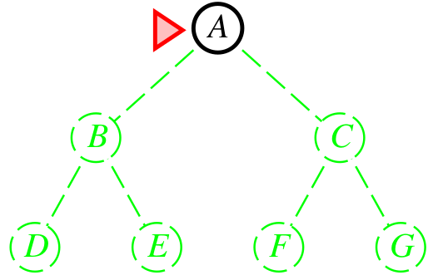
Breadth-First Search Strategy (BFS)
Breadth-First Search
Idea: Expand first the shallowest unexpanded nodes Implementation: frontier/fringe implemented as a FIFO queue
=⇒ novel successors pushed to the end of the queue
(Oc D. Klein, P. Abbeel, S. Levine, S. Russell, U. Berkeley)
41 / 96

Slide 110
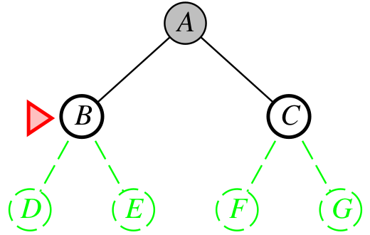
Breadth-First Search Strategy (BFS)
Breadth-First Search
Idea: Expand first the shallowest unexpanded nodes Implementation: frontier/fringe implemented as a FIFO queue
=⇒ novel successors pushed to the end of the queue
(Oc D. Klein, P. Abbeel, S. Levine, S. Russell, U. Berkeley)
41 / 96

Slide 111
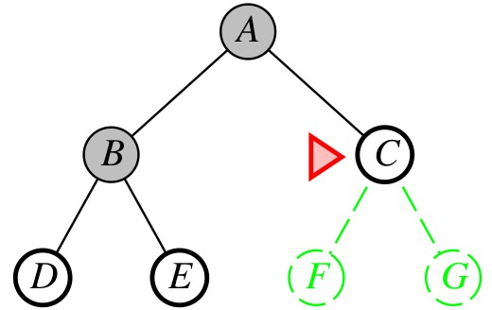
Breadth-First Search Strategy (BFS)
Breadth-First Search
Idea: Expand first the shallowest unexpanded nodes Implementation: frontier/fringe implemented as a FIFO queue
=⇒ novel successors pushed to the end of the queue
(Oc D. Klein, P. Abbeel, S. Levine, S. Russell, U. Berkeley)
41 / 96

Slide 112
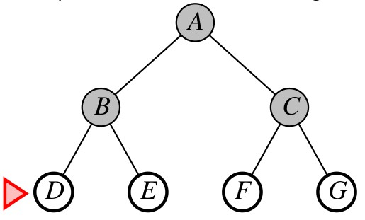
Breadth-First Search Strategy (BFS)
Breadth-First Search
Idea: Expand first the shallowest unexpanded nodes Implementation: frontier/fringe implemented as a FIFO queue
=⇒ novel successors pushed to the end of the queue
(Oc D. Klein, P. Abbeel, S. Levine, S. Russell, U. Berkeley)
41 / 96

Slide 113
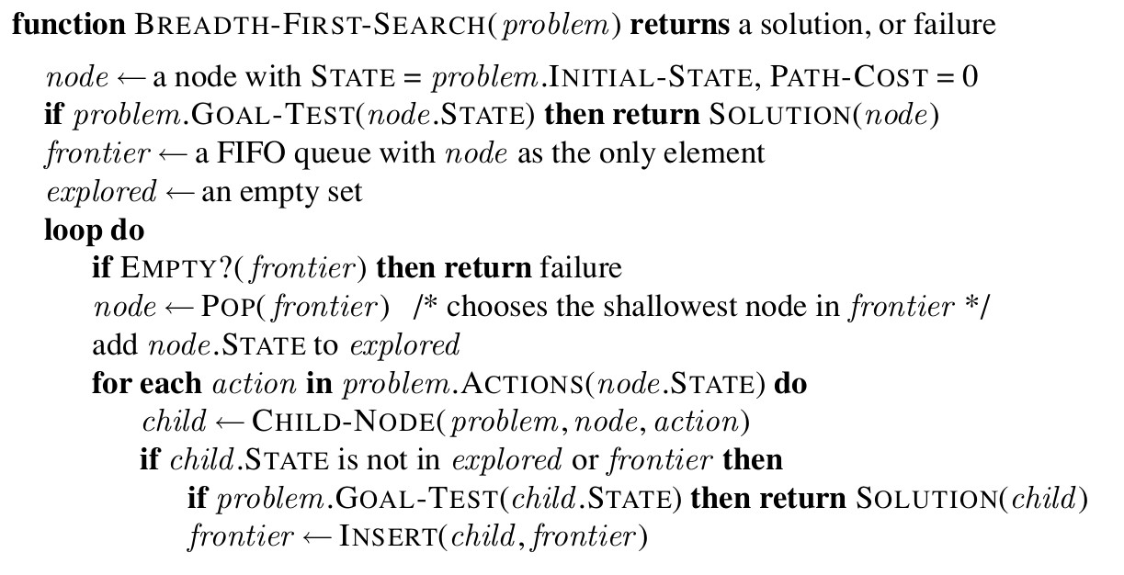
Breadth-First Search Strategy (BFS) [cont.]
BFS, Graph version (Tree version without “explored”)
(Oc S. Russell & P. Norwig, AIMA)
Note: the goal test is applied to each node when it is generated, rather than when it is selected for expansion
=⇒ solution detected 1 layer earlier

Slide 114
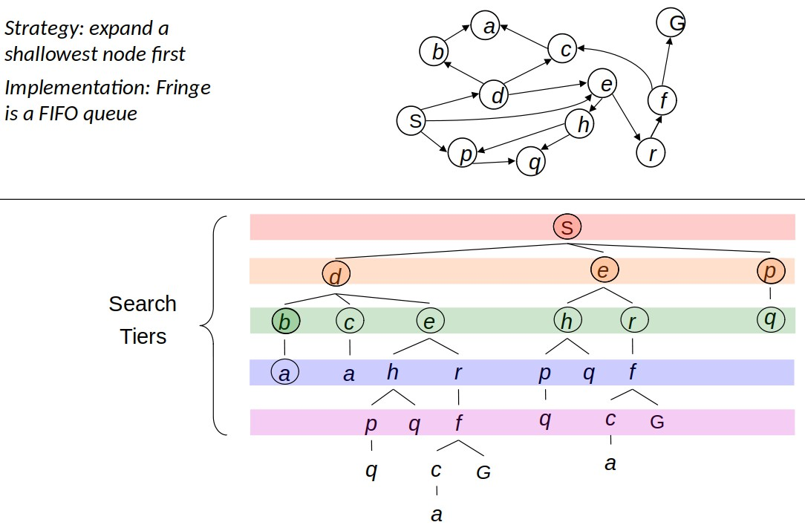
Breadth-First Search: Tiers
State space is explored by tiers (tree version)
(Oc D. Klein, P. Abbeel, S. Levine, S. Russell, U. Berkeley)

Slide 115
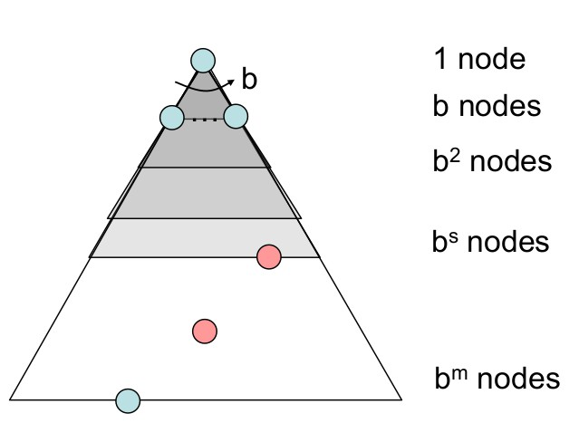
Breadth-First Search (BFS): Properties
d : depth of shallowest solution How many steps?
processes all nodes above shallowest solution
=⇒ takes O(b^{d} ) time
How much memory?
max frontier size: b^{d} nodes
=⇒ O(b^{d} ) memory size
Is it complete?
if solution exists, b^{d} finite
=⇒ Yes
Is it optimal?
if and only if all costs are 1
=⇒ shallowest solution
(Oc D. Klein, P. Abbeel, S. Levine, S. Russell, U. Berkeley)
Memory requirement is a major problem for breadth-first search

Slide 116
Breadth-First Search (BFS): Properties
d : depth of shallowest solution How many steps?
processes all nodes above shallowest solution
=⇒ takes O(b^{d} ) time
How much memory?
max frontier size: b^{d} nodes
=⇒ O(b^{d} ) memory size
Is it complete?
if solution exists, b^{d} finite
=⇒ Yes
Is it optimal?
if and only if all costs are 1
=⇒ shallowest solution
(Oc D. Klein, P. Abbeel, S. Levine, S. Russell, U. Berkeley)
Memory requirement is a major problem for breadth-first search
44 / 96

Slide 117
Breadth-First Search (BFS): Properties
d : depth of shallowest solution How many steps?
processes all nodes above shallowest solution
=⇒ takes O(b^{d} ) time
How much memory?
max frontier size: b^{d} nodes
=⇒ O(b^{d} ) memory size
Is it complete?
if solution exists, b^{d} finite
=⇒ Yes
Is it optimal?
if and only if all costs are 1
=⇒ shallowest solution
(Oc D. Klein, P. Abbeel, S. Levine, S. Russell, U. Berkeley)
Memory requirement is a major problem for breadth-first search
44 / 96

Slide 118
Breadth-First Search (BFS): Properties
d : depth of shallowest solution How many steps?
processes all nodes above shallowest solution
=⇒ takes O(b^{d} ) time
How much memory?
max frontier size: b^{d} nodes
=⇒ O(b^{d} ) memory size
Is it complete?
if solution exists, b^{d} finite
=⇒ Yes
Is it optimal?
if and only if all costs are 1
=⇒ shallowest solution
(Oc D. Klein, P. Abbeel, S. Levine, S. Russell, U. Berkeley)
Memory requirement is a major problem for breadth-first search
44 / 96

Slide 119
Breadth-First Search (BFS): Properties
d : depth of shallowest solution How many steps?
processes all nodes above shallowest solution
=⇒ takes O(b^{d} ) time
How much memory?
max frontier size: b^{d} nodes
=⇒ O(b^{d} ) memory size
Is it complete?
if solution exists, b^{d} finite
=⇒ Yes
Is it optimal?
if and only if all costs are 1
=⇒ shallowest solution
(Oc D. Klein, P. Abbeel, S. Levine, S. Russell, U. Berkeley)
Memory requirement is a major problem for breadth-first search
44 / 96

Slide 120
Breadth-First Search (BFS): Properties
d : depth of shallowest solution How many steps?
processes all nodes above shallowest solution
=⇒ takes O(b^{d} ) time
How much memory?
max frontier size: b^{d} nodes
=⇒ O(b^{d} ) memory size
Is it complete?
if solution exists, b^{d} finite
=⇒ Yes
Is it optimal?
if and only if all costs are 1
=⇒ shallowest solution
(Oc D. Klein, P. Abbeel, S. Levine, S. Russell, U. Berkeley)
Memory requirement is a major problem for breadth-first search
44 / 96

Slide 121
Breadth-First Search (BFS): Properties
d : depth of shallowest solution How many steps?
processes all nodes above shallowest solution
=⇒ takes O(b^{d} ) time
How much memory?
max frontier size: b^{d} nodes
=⇒ O(b^{d} ) memory size
Is it complete?
if solution exists, b^{d} finite
=⇒ Yes
Is it optimal?
if and only if all costs are 1
=⇒ shallowest solution
(Oc D. Klein, P. Abbeel, S. Levine, S. Russell, U. Berkeley)
Memory requirement is a major problem for breadth-first search
44 / 96

Slide 122
Breadth-First Search (BFS): Properties
d : depth of shallowest solution How many steps?
processes all nodes above shallowest solution
=⇒ takes O(b^{d} ) time
How much memory?
max frontier size: b^{d} nodes
=⇒ O(b^{d} ) memory size
Is it complete?
if solution exists, b^{d} finite
=⇒ Yes
Is it optimal?
if and only if all costs are 1
=⇒ shallowest solution
(Oc D. Klein, P. Abbeel, S. Levine, S. Russell, U. Berkeley)
Memory requirement is a major problem for breadth-first search
44 / 96

Slide 123
Breadth-First Search (BFS): Properties
d : depth of shallowest solution How many steps?
processes all nodes above shallowest solution
=⇒ takes O(b^{d} ) time
How much memory?
max frontier size: b^{d} nodes
=⇒ O(b^{d} ) memory size
Is it complete?
if solution exists, b^{d} finite
=⇒ Yes
Is it optimal?
if and only if all costs are 1
=⇒ shallowest solution
(Oc D. Klein, P. Abbeel, S. Levine, S. Russell, U. Berkeley)
Memory requirement is a major problem for breadth-first search

Slide 124
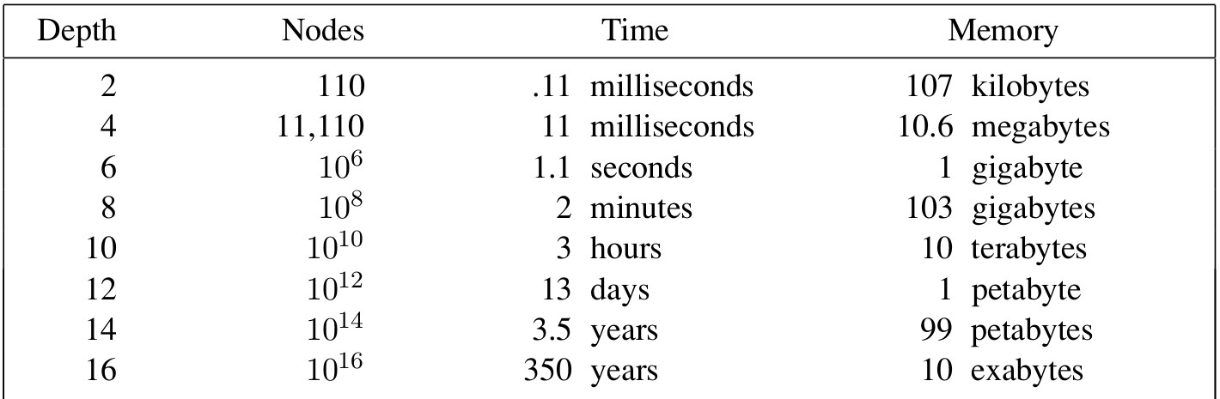
Breadth-First Search (BFS): Time and Memory
Assume:
1 million nodes generated per second 1 node requires 1000 bytes of storage branching factor b = 10
(Oc S. Russell & P. Norwig, AIMA)
Memory requirements bigger problem for BFS than execution time

Slide 125
Outline
1
Problem-Solving Agents
Example Problems Search Generalities
Uninformed Search Strategies Breadth-First Search Uniform-cost Search
Depth-First Search
Depth-Limited Search & Iterative Deepening
Informed Search Strategies Greedy Search
A∗ Search Heuristic Functions
2
3
4
5

Slide 126
Uniform-Cost Search Strategy (UCS)
Uniform-Cost Search
Idea: Expand first the node with lowest path cost g(n)
Implementation: frontier/fringe implemented as a priority queue ordered by g()
=⇒ novel nearest successors pushed to the top of the queue
similar to BFS if step costs are all equal
(Courtesy of Michela Milano, UniBO)
47 / 96

Slide 127
Uniform-Cost Search Strategy (UCS)
Uniform-Cost Search
Idea: Expand first the node with lowest path cost g(n)
Implementation: frontier/fringe implemented as a priority queue ordered by g()
=⇒ novel nearest successors pushed to the top of the queue
similar to BFS if step costs are all equal
(Courtesy of Michela Milano, UniBO)
47 / 96

Slide 128
Uniform-Cost Search Strategy (UCS)
Uniform-Cost Search
Idea: Expand first the node with lowest path cost g(n)
Implementation: frontier/fringe implemented as a priority queue ordered by g()
=⇒ novel nearest successors pushed to the top of the queue
similar to BFS if step costs are all equal
(Courtesy of Michela Milano, UniBO)
47 / 96

Slide 129
Uniform-Cost Search Strategy (UCS)
Uniform-Cost Search
Idea: Expand first the node with lowest path cost g(n)
Implementation: frontier/fringe implemented as a priority queue ordered by g()
=⇒ novel nearest successors pushed to the top of the queue
similar to BFS if step costs are all equal
(Courtesy of Michela Milano, UniBO)
47 / 96

Slide 130
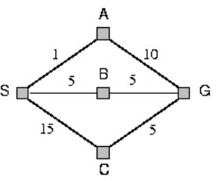
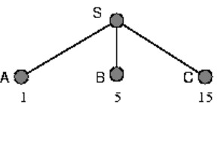
Uniform-Cost Search Strategy (UCS)
Uniform-Cost Search
Idea: Expand first the node with lowest path cost g(n)
Implementation: frontier/fringe implemented as a priority queue ordered by g()
=⇒ novel nearest successors pushed to the top of the queue
similar to BFS if step costs are all equal
(Courtesy of Michela Milano, UniBO)
47 / 96

Slide 131
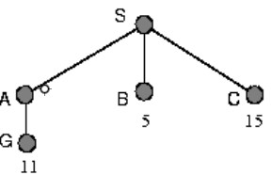
Uniform-Cost Search Strategy (UCS)
Uniform-Cost Search
Idea: Expand first the node with lowest path cost g(n)
Implementation: frontier/fringe implemented as a priority queue ordered by g()
=⇒ novel nearest successors pushed to the top of the queue
similar to BFS if step costs are all equal
(Courtesy of Michela Milano, UniBO)
47 / 96

Slide 132
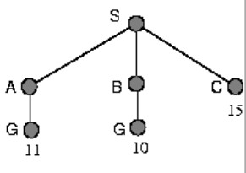
Uniform-Cost Search Strategy (UCS)
Uniform-Cost Search
Idea: Expand first the node with lowest path cost g(n)
Implementation: frontier/fringe implemented as a priority queue ordered by g()
=⇒ novel nearest successors pushed to the top of the queue
similar to BFS if step costs are all equal
(Courtesy of Michela Milano, UniBO)
47 / 96

Slide 133
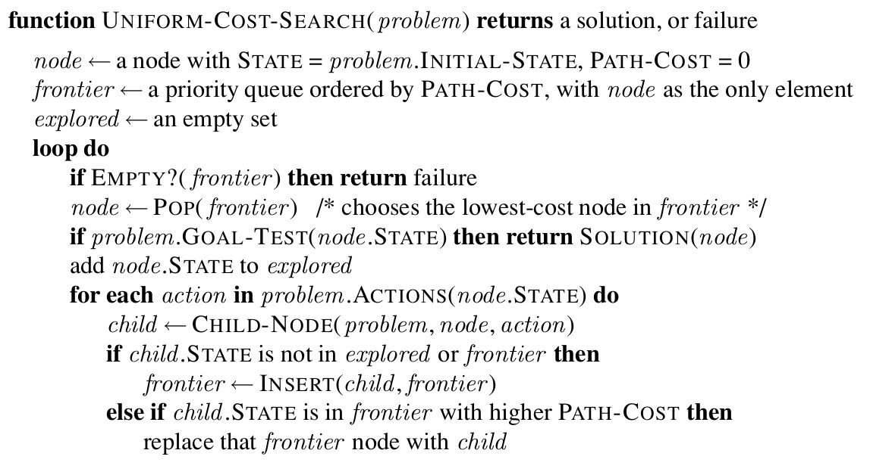
Uniform-Cost Search Strategy (UCS) [cont.]
UCS, Graph version (Tree version without “explored”)
(Oc S. Russell & P. Norwig, AIMA)
apply the goal test to a node when it is selected for expansion rather than when it is first generated
replace in the frontier a node with same state but worse path cost
=⇒ avoid generating suboptimal paths

Slide 134
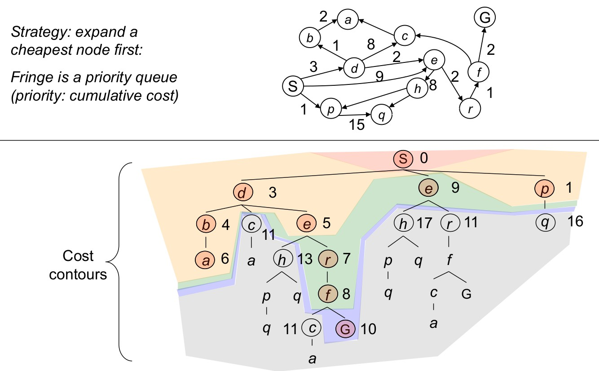
Uniform-Cost Search
(Oc D. Klein, P. Abbeel, S. Levine, S. Russell, U. Berkeley)

Slide 135
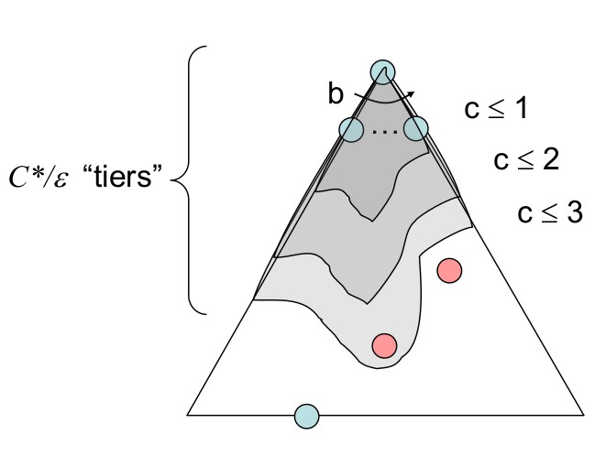
Uniform-Cost Search (UCS): Properties
C∗: cost of cheapest solution; c: minimum arc cost
=⇒ 1 + lC∗/cJ “effective depth” How many steps?
processes all nodes costing less than cheapest solution
=⇒ takes O(b^{1+LC∗/cJ}) time
How much memory?
max frontier size: b^{1+LC∗/cJ}
=⇒ O(b^{1+LC∗/cJ}) memory size
Is it complete?
if solution exists, finite cost
=⇒ Yes
Is it optimal?
Yes
(Oc D. Klein, P. Abbeel, S. Levine, S. Russell, U. Berkeley)
Memory requirement is a major problem also for uniform-cost search

Slide 136
Uniform-Cost Search (UCS): Properties
C∗: cost of cheapest solution; c: minimum arc cost
=⇒ 1 + lC∗/cJ “effective depth” How many steps?
processes all nodes costing less than cheapest solution
=⇒ takes O(b^{1+LC∗/cJ}) time
How much memory?
max frontier size: b^{1+LC∗/cJ}
=⇒ O(b^{1+LC∗/cJ}) memory size
Is it complete?
if solution exists, finite cost
=⇒ Yes
Is it optimal?
Yes
(Oc D. Klein, P. Abbeel, S. Levine, S. Russell, U. Berkeley)
Memory requirement is a major problem also for uniform-cost search
50 / 96

Slide 137
Uniform-Cost Search (UCS): Properties
C∗: cost of cheapest solution; c: minimum arc cost
=⇒ 1 + lC∗/cJ “effective depth” How many steps?
processes all nodes costing less than cheapest solution
=⇒ takes O(b^{1+LC∗/cJ}) time
How much memory?
max frontier size: b^{1+LC∗/cJ}
=⇒ O(b^{1+LC∗/cJ}) memory size
Is it complete?
if solution exists, finite cost
=⇒ Yes
Is it optimal?
Yes
(Oc D. Klein, P. Abbeel, S. Levine, S. Russell, U. Berkeley)
Memory requirement is a major problem also for uniform-cost search
50 / 96

Slide 138
Uniform-Cost Search (UCS): Properties
C∗: cost of cheapest solution; c: minimum arc cost
=⇒ 1 + lC∗/cJ “effective depth” How many steps?
processes all nodes costing less than cheapest solution
=⇒ takes O(b^{1+LC∗/cJ}) time
How much memory?
max frontier size: b^{1+LC∗/cJ}
=⇒ O(b^{1+LC∗/cJ}) memory size
Is it complete?
if solution exists, finite cost
=⇒ Yes
Is it optimal?
Yes
(Oc D. Klein, P. Abbeel, S. Levine, S. Russell, U. Berkeley)
Memory requirement is a major problem also for uniform-cost search
50 / 96

Slide 139
Uniform-Cost Search (UCS): Properties
C∗: cost of cheapest solution; c: minimum arc cost
=⇒ 1 + lC∗/cJ “effective depth” How many steps?
processes all nodes costing less than cheapest solution
=⇒ takes O(b^{1+LC∗/cJ}) time
How much memory?
max frontier size: b^{1+LC∗/cJ}
=⇒ O(b^{1+LC∗/cJ}) memory size
Is it complete?
if solution exists, finite cost
=⇒ Yes
Is it optimal?
Yes
(Oc D. Klein, P. Abbeel, S. Levine, S. Russell, U. Berkeley)
Memory requirement is a major problem also for uniform-cost search
50 / 96

Slide 140
Uniform-Cost Search (UCS): Properties
C∗: cost of cheapest solution; c: minimum arc cost
=⇒ 1 + lC∗/cJ “effective depth” How many steps?
processes all nodes costing less than cheapest solution
=⇒ takes O(b^{1+LC∗/cJ}) time
How much memory?
max frontier size: b^{1+LC∗/cJ}
=⇒ O(b^{1+LC∗/cJ}) memory size
Is it complete?
if solution exists, finite cost
=⇒ Yes
Is it optimal?
Yes
(Oc D. Klein, P. Abbeel, S. Levine, S. Russell, U. Berkeley)
Memory requirement is a major problem also for uniform-cost search
50 / 96

Slide 141
Uniform-Cost Search (UCS): Properties
C∗: cost of cheapest solution; c: minimum arc cost
=⇒ 1 + lC∗/cJ “effective depth” How many steps?
processes all nodes costing less than cheapest solution
=⇒ takes O(b^{1+LC∗/cJ}) time
How much memory?
max frontier size: b^{1+LC∗/cJ}
=⇒ O(b^{1+LC∗/cJ}) memory size
Is it complete?
if solution exists, finite cost
=⇒ Yes
Is it optimal?
Yes
(Oc D. Klein, P. Abbeel, S. Levine, S. Russell, U. Berkeley)
Memory requirement is a major problem also for uniform-cost search
50 / 96

Slide 142
Uniform-Cost Search (UCS): Properties
C∗: cost of cheapest solution; c: minimum arc cost
=⇒ 1 + lC∗/cJ “effective depth” How many steps?
processes all nodes costing less than cheapest solution
=⇒ takes O(b^{1+LC∗/cJ}) time
How much memory?
max frontier size: b^{1+LC∗/cJ}
=⇒ O(b^{1+LC∗/cJ}) memory size
Is it complete?
if solution exists, finite cost
=⇒ Yes
Is it optimal?
Yes
(Oc D. Klein, P. Abbeel, S. Levine, S. Russell, U. Berkeley)
Memory requirement is a major problem also for uniform-cost search
50 / 96

Slide 143
Uniform-Cost Search (UCS): Properties
C∗: cost of cheapest solution; c: minimum arc cost
=⇒ 1 + lC∗/cJ “effective depth” How many steps?
processes all nodes costing less than cheapest solution
=⇒ takes O(b^{1+LC∗/cJ}) time
How much memory?
max frontier size: b^{1+LC∗/cJ}
=⇒ O(b^{1+LC∗/cJ}) memory size
Is it complete?
if solution exists, finite cost
=⇒ Yes
Is it optimal?
Yes
(Oc D. Klein, P. Abbeel, S. Levine, S. Russell, U. Berkeley)
Memory requirement is a major problem also for uniform-cost search

Slide 144
Outline
1
Problem-Solving Agents
Example Problems Search Generalities
Uninformed Search Strategies Breadth-First Search Uniform-cost Search
Depth-First Search
Depth-Limited Search & Iterative Deepening
Informed Search Strategies Greedy Search
A∗ Search Heuristic Functions
2
3
4
5

Slide 145
Depth-First Search Strategy (DFS)
Depth-First Search
Idea: Expand first the deepest unexpanded nodes
Implementation: frontier/fringe implemented as a LIFO queue (aka stack)
=⇒ novel successors pushed to the top of the stack
(Oc D. Klein, P. Abbeel, S. Levine, S. Russell, U. Berkeley)
52 / 96

Slide 146
Depth-First Search Strategy (DFS)
Depth-First Search
Idea: Expand first the deepest unexpanded nodes
Implementation: frontier/fringe implemented as a LIFO queue (aka stack)
=⇒ novel successors pushed to the top of the stack
(Oc D. Klein, P. Abbeel, S. Levine, S. Russell, U. Berkeley)
52 / 96

Slide 147
Depth-First Search Strategy (DFS)
Depth-First Search
Idea: Expand first the deepest unexpanded nodes
Implementation: frontier/fringe implemented as a LIFO queue (aka stack)
=⇒ novel successors pushed to the top of the stack
(Oc D. Klein, P. Abbeel, S. Levine, S. Russell, U. Berkeley)
52 / 96

Slide 148
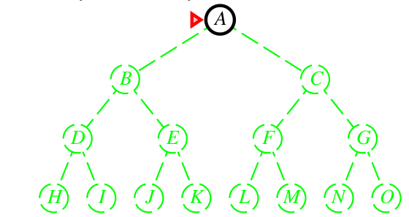
Depth-First Search Strategy (DFS)
Depth-First Search
Idea: Expand first the deepest unexpanded nodes
Implementation: frontier/fringe implemented as a LIFO queue (aka stack)
=⇒ novel successors pushed to the top of the stack
(Oc D. Klein, P. Abbeel, S. Levine, S. Russell, U. Berkeley)
52 / 96

Slide 149
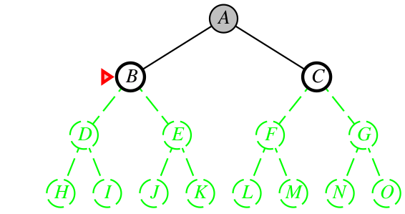
Depth-First Search Strategy (DFS)
Depth-First Search
Idea: Expand first the deepest unexpanded nodes
Implementation: frontier/fringe implemented as a LIFO queue (aka stack)
=⇒ novel successors pushed to the top of the stack
(Oc D. Klein, P. Abbeel, S. Levine, S. Russell, U. Berkeley)
52 / 96

Slide 150
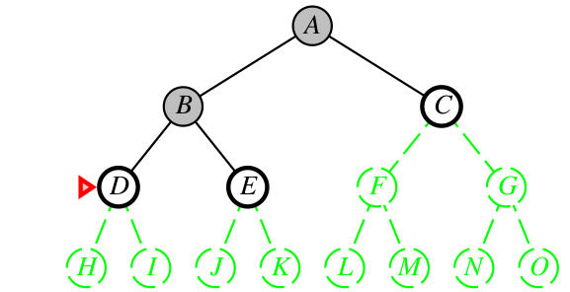
Depth-First Search Strategy (DFS)
Depth-First Search
Idea: Expand first the deepest unexpanded nodes
Implementation: frontier/fringe implemented as a LIFO queue (aka stack)
=⇒ novel successors pushed to the top of the stack
(Oc D. Klein, P. Abbeel, S. Levine, S. Russell, U. Berkeley)
52 / 96

Slide 151
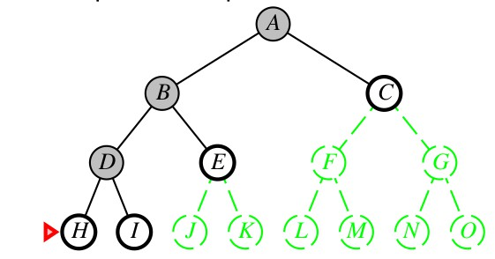
Depth-First Search Strategy (DFS)
Depth-First Search
Idea: Expand first the deepest unexpanded nodes
Implementation: frontier/fringe implemented as a LIFO queue (aka stack)
=⇒ novel successors pushed to the top of the stack
(Oc D. Klein, P. Abbeel, S. Levine, S. Russell, U. Berkeley)
52 / 96

Slide 152
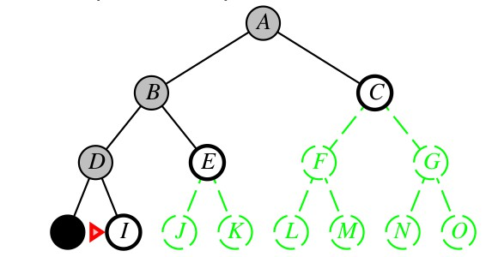
Depth-First Search Strategy (DFS)
Depth-First Search
Idea: Expand first the deepest unexpanded nodes
Implementation: frontier/fringe implemented as a LIFO queue (aka stack)
=⇒ novel successors pushed to the top of the stack
(Oc D. Klein, P. Abbeel, S. Levine, S. Russell, U. Berkeley)
52 / 96

Slide 153
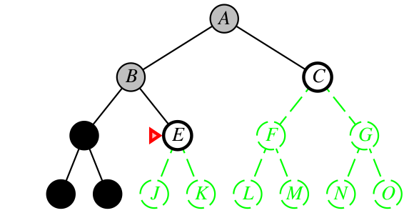
Depth-First Search Strategy (DFS)
Depth-First Search
Idea: Expand first the deepest unexpanded nodes
Implementation: frontier/fringe implemented as a LIFO queue (aka stack)
=⇒ novel successors pushed to the top of the stack
(Oc D. Klein, P. Abbeel, S. Levine, S. Russell, U. Berkeley)
52 / 96

Slide 154
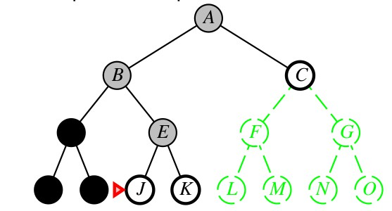
Depth-First Search Strategy (DFS)
Depth-First Search
Idea: Expand first the deepest unexpanded nodes
Implementation: frontier/fringe implemented as a LIFO queue (aka stack)
=⇒ novel successors pushed to the top of the stack
(Oc D. Klein, P. Abbeel, S. Levine, S. Russell, U. Berkeley)
52 / 96

Slide 155
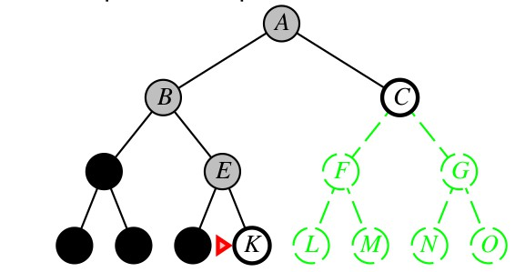
Depth-First Search Strategy (DFS)
Depth-First Search
Idea: Expand first the deepest unexpanded nodes
Implementation: frontier/fringe implemented as a LIFO queue (aka stack)
=⇒ novel successors pushed to the top of the stack
(Oc D. Klein, P. Abbeel, S. Levine, S. Russell, U. Berkeley)
52 / 96

Slide 156

Depth-First Search Strategy (DFS)
Depth-First Search
Idea: Expand first the deepest unexpanded nodes
Implementation: frontier/fringe implemented as a LIFO queue (aka stack)
=⇒ novel successors pushed to the top of the stack
(Oc D. Klein, P. Abbeel, S. Levine, S. Russell, U. Berkeley)
52 / 96

Slide 157

Depth-First Search Strategy (DFS)
Depth-First Search
Idea: Expand first the deepest unexpanded nodes
Implementation: frontier/fringe implemented as a LIFO queue (aka stack)
=⇒ novel successors pushed to the top of the stack
(Oc D. Klein, P. Abbeel, S. Levine, S. Russell, U. Berkeley)
52 / 96

Slide 158
Depth-First Search
DFS on a Graph
Similar to BFS, using a LIFO access for frontier/fringe rather than FIFO.

Slide 159

Depth-First Search
(Oc D. Klein, P. Abbeel, S. Levine, S. Russell, U. Berkeley)

Slide 160

Depth-First Search (DFS): Properties
How many steps?
could process the whole tree! =⇒ if m finite, takes O(b^{m} ) time
How much memory?
only siblings on path to root
=⇒ O(bm) memory size
Is it complete?
if infinite state space: no if finite state space:
(Oc D. Klein, P. Abbeel, S. Levine, S. Russell, U. Berkeley)
Is it optimal?
No, regardless of depth/cost
=⇒ “leftmost” solution
Memory requirement much better than BFS: O(bm) vs. O(b^{d} )!
=⇒ typically preferred to BFS
55 / 96

Slide 161
Depth-First Search (DFS): Properties
How many steps?
could process the whole tree! =⇒ if m finite, takes O(b^{m} ) time
How much memory?
only siblings on path to root
=⇒ O(bm) memory size
Is it complete?
if infinite state space: no if finite state space:
(Oc D. Klein, P. Abbeel, S. Levine, S. Russell, U. Berkeley)
Is it optimal?
No, regardless of depth/cost
=⇒ “leftmost” solution
Memory requirement much better than BFS: O(bm) vs. O(b^{d} )!
=⇒ typically preferred to BFS
55 / 96

Slide 162
Depth-First Search (DFS): Properties
How many steps?
could process the whole tree! =⇒ if m finite, takes O(b^{m} ) time
How much memory?
only siblings on path to root
=⇒ O(bm) memory size
Is it complete?
if infinite state space: no if finite state space:
(Oc D. Klein, P. Abbeel, S. Levine, S. Russell, U. Berkeley)
Is it optimal?
No, regardless of depth/cost
=⇒ “leftmost” solution
Memory requirement much better than BFS: O(bm) vs. O(b^{d} )!
=⇒ typically preferred to BFS
55 / 96

Slide 163
Depth-First Search (DFS): Properties
How many steps?
could process the whole tree! =⇒ if m finite, takes O(b^{m} ) time
How much memory?
only siblings on path to root
=⇒ O(bm) memory size
Is it complete?
if infinite state space: no if finite state space:
(Oc D. Klein, P. Abbeel, S. Levine, S. Russell, U. Berkeley)
Is it optimal?
No, regardless of depth/cost
=⇒ “leftmost” solution
Memory requirement much better than BFS: O(bm) vs. O(b^{d} )!
=⇒ typically preferred to BFS
55 / 96

Slide 164
Depth-First Search (DFS): Properties
How many steps?
could process the whole tree! =⇒ if m finite, takes O(b^{m} ) time
How much memory?
only siblings on path to root
=⇒ O(bm) memory size
Is it complete?
if infinite state space: no if finite state space:
graph version: yes tree version: only if we prevent loops
Is it optimal?
No, regardless of depth/cost
=⇒ “leftmost” solution
(Oc D. Klein, P. Abbeel, S. Levine, S. Russell, U. Berkeley)
Memory requirement much better than BFS: O(bm) vs. O(b^{d} )!
=⇒ typically preferred to BFS
55 / 96

Slide 165
Depth-First Search (DFS): Properties
How many steps?
could process the whole tree! =⇒ if m finite, takes O(b^{m} ) time
How much memory?
only siblings on path to root
=⇒ O(bm) memory size
Is it complete?
if infinite state space: no if finite state space:
graph version: yes tree version: only if we prevent loops
Is it optimal?
No, regardless of depth/cost
=⇒ “leftmost” solution
(Oc D. Klein, P. Abbeel, S. Levine, S. Russell, U. Berkeley)
Memory requirement much better than BFS: O(bm) vs. O(b^{d} )!
=⇒ typically preferred to BFS
55 / 96

Slide 166
Depth-First Search (DFS): Properties
How many steps?
could process the whole tree! =⇒ if m finite, takes O(b^{m} ) time
How much memory?
only siblings on path to root
=⇒ O(bm) memory size
Is it complete?
if infinite state space: no if finite state space:
graph version: yes tree version: only if we prevent loops
Is it optimal?
No, regardless of depth/cost
=⇒ “leftmost” solution
(Oc D. Klein, P. Abbeel, S. Levine, S. Russell, U. Berkeley)
Memory requirement much better than BFS: O(bm) vs. O(b^{d} )!
=⇒ typically preferred to BFS
55 / 96

Slide 167
Depth-First Search (DFS): Properties
How many steps?
could process the whole tree! =⇒ if m finite, takes O(b^{m} ) time
How much memory?
only siblings on path to root
=⇒ O(bm) memory size
Is it complete?
if infinite state space: no if finite state space:
graph version: yes tree version: only if we prevent loops
Is it optimal?
No, regardless of depth/cost
=⇒ “leftmost” solution
(Oc D. Klein, P. Abbeel, S. Levine, S. Russell, U. Berkeley)
Memory requirement much better than BFS: O(bm) vs. O(b^{d} )!
=⇒ typically preferred to BFS
55 / 96

Slide 168
Depth-First Search (DFS): Properties
How many steps?
could process the whole tree! =⇒ if m finite, takes O(b^{m} ) time
How much memory?
only siblings on path to root
=⇒ O(bm) memory size
Is it complete?
if infinite state space: no if finite state space:
graph version: yes tree version: only if we prevent loops
Is it optimal?
No, regardless of depth/cost
=⇒ “leftmost” solution
(Oc D. Klein, P. Abbeel, S. Levine, S. Russell, U. Berkeley)
Memory requirement much better than BFS: O(bm) vs. O(b^{d} )!
=⇒ typically preferred to BFS
55 / 96

Slide 169
Depth-First Search (DFS): Properties
How many steps?
could process the whole tree! =⇒ if m finite, takes O(b^{m} ) time
How much memory?
only siblings on path to root
=⇒ O(bm) memory size
Is it complete?
if infinite state space: no if finite state space:
graph version: yes tree version: only if we prevent loops
Is it optimal?
No, regardless of depth/cost
=⇒ “leftmost” solution
(Oc D. Klein, P. Abbeel, S. Levine, S. Russell, U. Berkeley)
Memory requirement much better than BFS: O(bm) vs. O(b^{d} )!
=⇒ typically preferred to BFS
55 / 96

Slide 170
Depth-First Search (DFS): Properties
How many steps?
could process the whole tree! =⇒ if m finite, takes O(b^{m} ) time
How much memory?
only siblings on path to root
=⇒ O(bm) memory size
Is it complete?
if infinite state space: no if finite state space:
graph version: yes tree version: only if we prevent loops
Is it optimal?
No, regardless of depth/cost
=⇒ “leftmost” solution
(Oc D. Klein, P. Abbeel, S. Levine, S. Russell, U. Berkeley)
Memory requirement much better than BFS: O(bm) vs. O(b^{d} )!
=⇒ typically preferred to BFS
55 / 96

Slide 171
Depth-First Search (DFS): Properties
How many steps?
could process the whole tree! =⇒ if m finite, takes O(b^{m} ) time
How much memory?
only siblings on path to root
=⇒ O(bm) memory size
Is it complete?
if infinite state space: no if finite state space:
graph version: yes tree version: only if we prevent loops
Is it optimal?
No, regardless of depth/cost
=⇒ “leftmost” solution
(Oc D. Klein, P. Abbeel, S. Levine, S. Russell, U. Berkeley)
Memory requirement much better than BFS: O(bm) vs. O(b^{d} )!
=⇒ typically preferred to BFS
55 / 96

Slide 172
A Variant of DFS: Backtracking Search
Backtracking Search
Idea: only one successor is generated at the time
each partially-expanded node remembers which successor to generate next
generate a successor by modifying the current state description, rather than copying it firs
Applied in CSP, SAT/SMT and Logic Programming
=⇒ only O(m) memory is needed rather than O(bm)
56 / 96

Slide 173
A Variant of DFS: Backtracking Search
Backtracking Search
Idea: only one successor is generated at the time
each partially-expanded node remembers which successor to generate next
generate a successor by modifying the current state description, rather than copying it firs
Applied in CSP, SAT/SMT and Logic Programming
=⇒ only O(m) memory is needed rather than O(bm)
56 / 96

Slide 174
Outline
1
Problem-Solving Agents
Example Problems Search Generalities
Uninformed Search Strategies Breadth-First Search Uniform-cost Search
Depth-First Search
Depth-Limited Search & Iterative Deepening
Informed Search Strategies Greedy Search
A∗ Search Heuristic Functions
2
3
4
5

Slide 175
Depth-Limited Search (DLS) Strategy
Depth-Limited Search (DLS)
Idea: depth-first search with depth limit l
i.e., nodes at depth l treated as having no successors DFS is DLS with l = +∞
solves the infinite-path problem of DFS
=⇒ allows DFS deal with infinite-state spaces
useful also if maximum-depth is known by domain knowledge e.g., if maximum node distance in a graph (diameter) is known Ex: Romania trip: 9 steps
Drawbacks (d : depth of the shallowest goal):
if d > l =⇒ incomplete
if d < l =⇒ takes O(b^{l} ) instead of O(b^{d} ) steps

Slide 176
Depth-Limited Search (DLS) Strategy
Depth-Limited Search (DLS)
Idea: depth-first search with depth limit l
i.e., nodes at depth l treated as having no successors DFS is DLS with l = +∞
solves the infinite-path problem of DFS
=⇒ allows DFS deal with infinite-state spaces
useful also if maximum-depth is known by domain knowledge e.g., if maximum node distance in a graph (diameter) is known Ex: Romania trip: 9 steps
Drawbacks (d : depth of the shallowest goal):
if d > l =⇒ incomplete
if d < l =⇒ takes O(b^{l} ) instead of O(b^{d} ) steps
58 / 96

Slide 177
Depth-Limited Search (DLS) Strategy
Depth-Limited Search (DLS)
Idea: depth-first search with depth limit l
i.e., nodes at depth l treated as having no successors DFS is DLS with l = +∞
solves the infinite-path problem of DFS
=⇒ allows DFS deal with infinite-state spaces
useful also if maximum-depth is known by domain knowledge e.g., if maximum node distance in a graph (diameter) is known Ex: Romania trip: 9 steps
Drawbacks (d : depth of the shallowest goal):
if d > l =⇒ incomplete
if d < l =⇒ takes O(b^{l} ) instead of O(b^{d} ) steps
58 / 96

Slide 178
Depth-Limited Search (DLS) Strategy
Depth-Limited Search (DLS)
Idea: depth-first search with depth limit l
i.e., nodes at depth l treated as having no successors DFS is DLS with l = +∞
solves the infinite-path problem of DFS
=⇒ allows DFS deal with infinite-state spaces
useful also if maximum-depth is known by domain knowledge e.g., if maximum node distance in a graph (diameter) is known Ex: Romania trip: 9 steps
Drawbacks (d : depth of the shallowest goal):
if d > l =⇒ incomplete
if d < l =⇒ takes O(b^{l} ) instead of O(b^{d} ) steps
58 / 96

Slide 179
Depth-Limited Search (DLS) Strategy
Depth-Limited Search (DLS)
Idea: depth-first search with depth limit l
i.e., nodes at depth l treated as having no successors DFS is DLS with l = +∞
solves the infinite-path problem of DFS
=⇒ allows DFS deal with infinite-state spaces
useful also if maximum-depth is known by domain knowledge e.g., if maximum node distance in a graph (diameter) is known Ex: Romania trip: 9 steps
Drawbacks (d : depth of the shallowest goal):
if d > l =⇒ incomplete
if d < l =⇒ takes O(b^{l} ) instead of O(b^{d} ) steps
58 / 96

Slide 180
Depth-Limited Search (DLS) Strategy
Depth-Limited Search (DLS)
Idea: depth-first search with depth limit l
i.e., nodes at depth l treated as having no successors DFS is DLS with l = +∞
solves the infinite-path problem of DFS
=⇒ allows DFS deal with infinite-state spaces
useful also if maximum-depth is known by domain knowledge e.g., if maximum node distance in a graph (diameter) is known Ex: Romania trip: 9 steps
Drawbacks (d : depth of the shallowest goal):
if d > l =⇒ incomplete
if d < l =⇒ takes O(b^{l} ) instead of O(b^{d} ) steps
58 / 96

Slide 181
Depth-Limited Search (DLS) Strategy
Depth-Limited Search (DLS)
Idea: depth-first search with depth limit l
i.e., nodes at depth l treated as having no successors DFS is DLS with l = +∞
solves the infinite-path problem of DFS
=⇒ allows DFS deal with infinite-state spaces
useful also if maximum-depth is known by domain knowledge e.g., if maximum node distance in a graph (diameter) is known Ex: Romania trip: 9 steps
Drawbacks (d : depth of the shallowest goal):
if d > l =⇒ incomplete
if d < l =⇒ takes O(b^{l} ) instead of O(b^{d} ) steps

Slide 182

Depth-Limited Search (DLS) Strategy [cont.]
Recursive DLS
(Oc S. Russell & P. Norwig, AIMA)

Slide 183

Iterative-Deepening Search Strategy (IDS)
Iterative-Deepening Search
Idea: call iteratively DLS for increasing depths l = 0, 1, 2, 3... combines the advantages of breadth- and depth-first strategies
complete (like BFS)
takes O(b^{d} ) steps (like BFS and DFS) requires O(bd ) memory (like DFS)
explores a single branch at a time (like DFS)
optimal only if step cost = 1
optimal variants exist: iterative-lengthening search (see AIMA)
The favorite search strategy when the search space is very large and depth is not known
(Oc S. Russell & P. Norwig, AIMA)
60 / 96

Slide 184
Iterative-Deepening Search Strategy (IDS)
Iterative-Deepening Search
Idea: call iteratively DLS for increasing depths l = 0, 1, 2, 3... combines the advantages of breadth- and depth-first strategies
complete (like BFS)
takes O(b^{d} ) steps (like BFS and DFS) requires O(bd ) memory (like DFS)
explores a single branch at a time (like DFS)
optimal only if step cost = 1
optimal variants exist: iterative-lengthening search (see AIMA)
The favorite search strategy when the search space is very large and depth is not known
(Oc S. Russell & P. Norwig, AIMA)
60 / 96

Slide 185
Iterative-Deepening Search Strategy (IDS)
Iterative-Deepening Search
Idea: call iteratively DLS for increasing depths l = 0, 1, 2, 3... combines the advantages of breadth- and depth-first strategies
complete (like BFS)
takes O(b^{d} ) steps (like BFS and DFS) requires O(bd ) memory (like DFS)
explores a single branch at a time (like DFS)
optimal only if step cost = 1
optimal variants exist: iterative-lengthening search (see AIMA)
The favorite search strategy when the search space is very large and depth is not known
(Oc S. Russell & P. Norwig, AIMA)
60 / 96

Slide 186
Iterative-Deepening Search Strategy (IDS)
Iterative-Deepening Search
Idea: call iteratively DLS for increasing depths l = 0, 1, 2, 3... combines the advantages of breadth- and depth-first strategies
complete (like BFS)
takes O(b^{d} ) steps (like BFS and DFS) requires O(bd ) memory (like DFS)
explores a single branch at a time (like DFS)
optimal only if step cost = 1
optimal variants exist: iterative-lengthening search (see AIMA)
The favorite search strategy when the search space is very large and depth is not known
(Oc S. Russell & P. Norwig, AIMA)
60 / 96

Slide 187
Iterative-Deepening Search Strategy (IDS)
Iterative-Deepening Search
Idea: call iteratively DLS for increasing depths l = 0, 1, 2, 3... combines the advantages of breadth- and depth-first strategies
complete (like BFS)
takes O(b^{d} ) steps (like BFS and DFS) requires O(bd ) memory (like DFS)
explores a single branch at a time (like DFS)
optimal only if step cost = 1
optimal variants exist: iterative-lengthening search (see AIMA)
The favorite search strategy when the search space is very large and depth is not known
(Oc S. Russell & P. Norwig, AIMA)
60 / 96

Slide 188
Iterative-Deepening Search Strategy (IDS)
Iterative-Deepening Search
Idea: call iteratively DLS for increasing depths l = 0, 1, 2, 3... combines the advantages of breadth- and depth-first strategies
complete (like BFS)
takes O(b^{d} ) steps (like BFS and DFS) requires O(bd ) memory (like DFS)
explores a single branch at a time (like DFS)
optimal only if step cost = 1
optimal variants exist: iterative-lengthening search (see AIMA)
The favorite search strategy when the search space is very large and depth is not known
(Oc S. Russell & P. Norwig, AIMA)
60 / 96

Slide 189
Iterative-Deepening Search Strategy (IDS)
Iterative-Deepening Search
Idea: call iteratively DLS for increasing depths l = 0, 1, 2, 3... combines the advantages of breadth- and depth-first strategies
complete (like BFS)
takes O(b^{d} ) steps (like BFS and DFS) requires O(bd ) memory (like DFS)
explores a single branch at a time (like DFS)
optimal only if step cost = 1
optimal variants exist: iterative-lengthening search (see AIMA)
The favorite search strategy when the search space is very large and depth is not known
(Oc S. Russell & P. Norwig, AIMA)
60 / 96

Slide 190
Iterative-Deepening Search Strategy (IDS)
Iterative-Deepening Search
Idea: call iteratively DLS for increasing depths l = 0, 1, 2, 3... combines the advantages of breadth- and depth-first strategies
complete (like BFS)
takes O(b^{d} ) steps (like BFS and DFS) requires O(bd ) memory (like DFS)
explores a single branch at a time (like DFS)
optimal only if step cost = 1
optimal variants exist: iterative-lengthening search (see AIMA)
The favorite search strategy when the search space is very large and depth is not known
(Oc S. Russell & P. Norwig, AIMA)
60 / 96

Slide 191
Iterative-Deepening Search: Example
(Oc S. Russell & P. Norwig, AIMA)
61 / 96

Slide 192
Iterative-Deepening Search: Example
(Oc S. Russell & P. Norwig, AIMA)
61 / 96

Slide 193

Iterative-Deepening Search: Example
(Oc S. Russell & P. Norwig, AIMA)
61 / 96

Slide 194

Iterative-Deepening Search: Example
(Oc S. Russell & P. Norwig, AIMA)
61 / 96

Slide 195
Iterative-Deepening Search Strategy (IDS) [cont.]
Remark: Why “only” O(b^{d} ) steps?
may seem wasteful since states are generated multiple times...
... however, only a small fraction of nodes are multiply generated
number of repeatedly-generated nodes decreases exponentially with number of repetitions
depth 1 (b nodes): repeated d times depth 2 (b² nodes): repeated d − 1 times
...
depth d (b^{d} nodes): repeated 1 time
=⇒ The total number of generated nodes is:
N(IDS) = (d )b¹ + (d − 1)b² + ... + (1)b^{d} = O(b^{d} )
N(BFS) = b¹ + b² + ... + b^{d} = O(b^{d} )
Ex: with b = 10 and d = 5:
N(IDS) = 50 + 400 + 3, 000 + 20, 000 + 100, 000 = 123, 000
N(BFS) = 10 + 100 + 1, 000 + 10, 000 + 100, 000 = 111, 110
=⇒ not significantly worse than BFS
62 / 96

Slide 196
Iterative-Deepening Search Strategy (IDS) [cont.]
Remark: Why “only” O(b^{d} ) steps?
may seem wasteful since states are generated multiple times...
... however, only a small fraction of nodes are multiply generated
number of repeatedly-generated nodes decreases exponentially with number of repetitions
depth 1 (b nodes): repeated d times depth 2 (b² nodes): repeated d − 1 times
...
depth d (b^{d} nodes): repeated 1 time
=⇒ The total number of generated nodes is:
N(IDS) = (d )b¹ + (d − 1)b² + ... + (1)b^{d} = O(b^{d} )
N(BFS) = b¹ + b² + ... + b^{d} = O(b^{d} )
Ex: with b = 10 and d = 5:
N(IDS) = 50 + 400 + 3, 000 + 20, 000 + 100, 000 = 123, 000
N(BFS) = 10 + 100 + 1, 000 + 10, 000 + 100, 000 = 111, 110
=⇒ not significantly worse than BFS
62 / 96

Slide 197
Iterative-Deepening Search Strategy (IDS) [cont.]
Remark: Why “only” O(b^{d} ) steps?
may seem wasteful since states are generated multiple times...
... however, only a small fraction of nodes are multiply generated
number of repeatedly-generated nodes decreases exponentially with number of repetitions
depth 1 (b nodes): repeated d times depth 2 (b² nodes): repeated d − 1 times
...
depth d (b^{d} nodes): repeated 1 time
=⇒ The total number of generated nodes is:
N(IDS) = (d )b¹ + (d − 1)b² + ... + (1)b^{d} = O(b^{d} )
N(BFS) = b¹ + b² + ... + b^{d} = O(b^{d} )
Ex: with b = 10 and d = 5:
N(IDS) = 50 + 400 + 3, 000 + 20, 000 + 100, 000 = 123, 000
N(BFS) = 10 + 100 + 1, 000 + 10, 000 + 100, 000 = 111, 110
=⇒ not significantly worse than BFS
62 / 96

Slide 198
Iterative-Deepening Search Strategy (IDS) [cont.]
Remark: Why “only” O(b^{d} ) steps?
may seem wasteful since states are generated multiple times...
... however, only a small fraction of nodes are multiply generated
number of repeatedly-generated nodes decreases exponentially with number of repetitions
depth 1 (b nodes): repeated d times depth 2 (b² nodes): repeated d − 1 times
...
depth d (b^{d} nodes): repeated 1 time
=⇒ The total number of generated nodes is:
N(IDS) = (d )b¹ + (d − 1)b² + ... + (1)b^{d} = O(b^{d} )
N(BFS) = b¹ + b² + ... + b^{d} = O(b^{d} )
Ex: with b = 10 and d = 5:
N(IDS) = 50 + 400 + 3, 000 + 20, 000 + 100, 000 = 123, 000
N(BFS) = 10 + 100 + 1, 000 + 10, 000 + 100, 000 = 111, 110
=⇒ not significantly worse than BFS
62 / 96

Slide 199
Iterative-Deepening Search Strategy (IDS) [cont.]
Remark: Why “only” O(b^{d} ) steps?
may seem wasteful since states are generated multiple times...
... however, only a small fraction of nodes are multiply generated
number of repeatedly-generated nodes decreases exponentially with number of repetitions
depth 1 (b nodes): repeated d times depth 2 (b² nodes): repeated d − 1 times
...
depth d (b^{d} nodes): repeated 1 time
=⇒ The total number of generated nodes is:
N(IDS) = (d )b¹ + (d − 1)b² + ... + (1)b^{d} = O(b^{d} )
N(BFS) = b¹ + b² + ... + b^{d} = O(b^{d} )
Ex: with b = 10 and d = 5:
N(IDS) = 50 + 400 + 3, 000 + 20, 000 + 100, 000 = 123, 000
N(BFS) = 10 + 100 + 1, 000 + 10, 000 + 100, 000 = 111, 110
=⇒ not significantly worse than BFS
62 / 96

Slide 200
Iterative-Deepening Search Strategy (IDS) [cont.]
Remark: Why “only” O(b^{d} ) steps?
may seem wasteful since states are generated multiple times...
... however, only a small fraction of nodes are multiply generated
number of repeatedly-generated nodes decreases exponentially with number of repetitions
depth 1 (b nodes): repeated d times depth 2 (b² nodes): repeated d − 1 times
...
depth d (b^{d} nodes): repeated 1 time
=⇒ The total number of generated nodes is:
N(IDS) = (d )b¹ + (d − 1)b² + ... + (1)b^{d} = O(b^{d} )
N(BFS) = b¹ + b² + ... + b^{d} = O(b^{d} )
Ex: with b = 10 and d = 5:
N(IDS) = 50 + 400 + 3, 000 + 20, 000 + 100, 000 = 123, 000
N(BFS) = 10 + 100 + 1, 000 + 10, 000 + 100, 000 = 111, 110
=⇒ not significantly worse than BFS
62 / 96

Slide 201
Iterative-Deepening Search Strategy (IDS) [cont.]
Remark: Why “only” O(b^{d} ) steps?
may seem wasteful since states are generated multiple times...
... however, only a small fraction of nodes are multiply generated
number of repeatedly-generated nodes decreases exponentially with number of repetitions
depth 1 (b nodes): repeated d times depth 2 (b² nodes): repeated d − 1 times
...
depth d (b^{d} nodes): repeated 1 time
=⇒ The total number of generated nodes is:
N(IDS) = (d )b¹ + (d − 1)b² + ... + (1)b^{d} = O(b^{d} )
N(BFS) = b¹ + b² + ... + b^{d} = O(b^{d} )
Ex: with b = 10 and d = 5:
N(IDS) = 50 + 400 + 3, 000 + 20, 000 + 100, 000 = 123, 000
N(BFS) = 10 + 100 + 1, 000 + 10, 000 + 100, 000 = 111, 110
=⇒ not significantly worse than BFS

Slide 202

Bidirectional Search [hints]
Idea: Two simultaneous searches: forward: from start node backward: from goal node
checking if the node belongs to the other frontier before expansion
Rationale: b^{d/2} + b^{d/2} << b^{d}
=⇒ number of steps and memory consumption are ≈ 2b^{d/2}
backward search can be tricky in some cases (e.g. 8-queens)
(Oc S. Russell & P. Norwig, AIMA)

Slide 203

Uninformed Search Strategies: Comparison
Evaluation of tree-search strategies
ª : complete if b is finite
^{b} : complete if step costs ≥ E for some positive E
^{c} : optimal if step costs are all identical
^{d} : if both directions use breadth-first search
(Oc S. Russell & P. Norwig, AIMA)
For graph searches, the main differences are:
depth-first search is complete for finite-state spaces
space & time complexities are bounded by the state space size

Slide 204
Outline
1
Problem-Solving Agents
Example Problems Search Generalities
Uninformed Search Strategies Breadth-First Search Uniform-cost Search
Depth-First Search
Depth-Limited Search & Iterative Deepening
Informed Search Strategies Greedy Search
A∗ Search Heuristic Functions
2
3
4
5

Slide 205
Informed Search Strategies
Some general principles
The intelligence of a system cannot be measured only in terms of search capacity, but in the ability to use knowledge about the problem to reduce/mitigate the combinatorial explosion
If the system has some control on the order in which candidate solutions are generated, then it is useful to use this order so that actual solutions have a high chance to appear earlier
Intelligence, for a system with limited processing capacity, is the wise choice of what to do next

Slide 206

Heuristic search and heuristic functions
Heuristic search and heuristic functions
Idea: don’t ignore the goal when selecting nodes
Intuition: often there is extra knowledge that can be used to guide the search towards the goal: heuristics
A heuristic is
a function h(n) that estimates how close a state n is to a goal designed for a particular search problem
Ex Manhattan distance, Euclidean distance for pathing
(Oc D. Klein, P. Abbeel, S. Levine, S. Russell, U. Berkeley)

Slide 207
Best-first Search Strategies
General approach of informed search: Best-first search
Best-first search: node selected for expansion based on an evaluation function f (n)
represent a cost estimate =⇒ choose node which appears best implemented like uniform-cost search, with f instead of g
=⇒ the frontier is a priority queue sorted in decreasing order of h(n)
both tree-based and graph-based versions most often f includes a heuristic function h(n)
Heuristic function h(n) ∈ R⁺: estimated cost of the cheapest path from the state at node n to a goal state
h(n) ≥ 0 ∀n
If G is goal, then h(G) = 0 implements extra domain knowledge
depends only on state, not on node (e.g., independent on paths)
Main strategies: Greedy search A∗ search

Slide 208
Best-first Search Strategies
General approach of informed search: Best-first search
Best-first search: node selected for expansion based on an evaluation function f (n)
represent a cost estimate =⇒ choose node which appears best implemented like uniform-cost search, with f instead of g
=⇒ the frontier is a priority queue sorted in decreasing order of h(n)
both tree-based and graph-based versions most often f includes a heuristic function h(n)
Heuristic function h(n) ∈ R⁺: estimated cost of the cheapest path from the state at node n to a goal state
h(n) ≥ 0 ∀n
If G is goal, then h(G) = 0 implements extra domain knowledge
depends only on state, not on node (e.g., independent on paths)
Main strategies: Greedy search A∗ search
68 / 96

Slide 209
Best-first Search Strategies
General approach of informed search: Best-first search
Best-first search: node selected for expansion based on an evaluation function f (n)
represent a cost estimate =⇒ choose node which appears best implemented like uniform-cost search, with f instead of g
=⇒ the frontier is a priority queue sorted in decreasing order of h(n)
both tree-based and graph-based versions most often f includes a heuristic function h(n)
Heuristic function h(n) ∈ R⁺: estimated cost of the cheapest path from the state at node n to a goal state
h(n) ≥ 0 ∀n
If G is goal, then h(G) = 0 implements extra domain knowledge
depends only on state, not on node (e.g., independent on paths)
Main strategies: Greedy search A∗ search

Slide 210

Example: Straight-Line Distance h_{SLD} (n)
h(n) =^{def} h_{SLD} (n): straight-line distance heuristic
different from actual minimum-path dinstance
cannot be computed from the problem description itself

Slide 211
Outline
1
Problem-Solving Agents
Example Problems Search Generalities
Uninformed Search Strategies Breadth-First Search Uniform-cost Search
Depth-First Search
Depth-Limited Search & Iterative Deepening
Informed Search Strategies Greedy Search
A∗ Search Heuristic Functions
2
3
4
5

Slide 212
Greedy Best-First Search Strategy (GBFS)
Greedy Best-First Search (aka Greedy Search)
Idea: Expand first the node n with lowest estimate cost to the closest goal, h(n)
Implementation: same as uniform-cost search, with g(n) =^{def} h(n)
=⇒ expands the node that appears to be closest to goal
both tree and graph versions
71 / 96

Slide 213
Greedy Best-First Search Strategy (GBFS)
Greedy Best-First Search (aka Greedy Search)
Idea: Expand first the node n with lowest estimate cost to the closest goal, h(n)
Implementation: same as uniform-cost search, with g(n) =^{def} h(n)
=⇒ expands the node that appears to be closest to goal
both tree and graph versions
71 / 96

Slide 214
Greedy Best-First Search Strategy (GBFS)
Greedy Best-First Search (aka Greedy Search)
Idea: Expand first the node n with lowest estimate cost to the closest goal, h(n)
Implementation: same as uniform-cost search, with g(n) =^{def} h(n)
=⇒ expands the node that appears to be closest to goal
both tree and graph versions
71 / 96

Slide 215
Greedy Best-First Search Strategy (GBFS)
Greedy Best-First Search (aka Greedy Search)
Idea: Expand first the node n with lowest estimate cost to the closest goal, h(n)
Implementation: same as uniform-cost search, with g(n) =^{def} h(n)
=⇒ expands the node that appears to be closest to goal
both tree and graph versions
71 / 96

Slide 216

Greedy Best-First Search Strategy: Example
(Oc S. Russell & P. Norwig, AIMA)
72 / 96

Slide 217

Greedy Best-First Search Strategy: Example
(Oc S. Russell & P. Norwig, AIMA)
72 / 96

Slide 218

Greedy Best-First Search Strategy: Example
(Oc S. Russell & P. Norwig, AIMA)
72 / 96

Slide 219

Greedy Best-First Search Strategy: Example
(Oc S. Russell & P. Norwig, AIMA)
72 / 96

Slide 220
Greedy Best-First Search Strategy: Example
(Arad, Sibiu, Fagaras, Pitesti)
72 / 96

Slide 221
Greedy Best-First Search Strategy: Example
Not optimal!
72 / 96

Slide 222
Greedy Best-First Search Strategy: Example
Optimal path: (Arad, Sibiu, Rimnicu Vilcea, Pitesti)

Slide 223
Greedy Best-First Search: (Non-)Optimality
Greedy best-first search is not optimal
it is not guaranteed to find the best solution
it is not guaranteed to find the best path toward a solution
picks the node with minimum (estimated) distance to goal, regardless the cost to reach it
Ex: when in Sibiu, it picks Fagaras rather than Rimnicu Vicea
(Oc S. Russell & P. Norwig, AIMA)

Slide 224

Greedy Best-First Search: (In-)Completeness
Tree-based Greedy best-first search is not complete
may lead to infinite loops
Graph-based version complete (if state space finite) substantially same completeness issues as DFS
(Courtesy of Maria Simi, UniPI)

Slide 225

Greedy Best-First Search (GBFS): Properties
How many steps?
in worst cases may explore all states
=⇒ takes O(b^{d} ) time if good heuristics:
=⇒ may give good
improvements
How much memory?
max frontier size: b^{d}
=⇒ O(b^{d} ) memory size
Is it complete?
tree: no
graph: yes if space finite
Is it optimal?
No
(Oc D. Klein, P. Abbeel, S. Levine, S. Russell, U. Berkeley)
Memory requirement is a major problem also for GBFS
75 / 96

Slide 226
Greedy Best-First Search (GBFS): Properties
How many steps?
in worst cases may explore all states
=⇒ takes O(b^{d} ) time if good heuristics:
=⇒ may give good
improvements
How much memory?
max frontier size: b^{d}
=⇒ O(b^{d} ) memory size
Is it complete?
tree: no
graph: yes if space finite
Is it optimal?
No
(Oc D. Klein, P. Abbeel, S. Levine, S. Russell, U. Berkeley)
Memory requirement is a major problem also for GBFS
75 / 96

Slide 227
Greedy Best-First Search (GBFS): Properties
How many steps?
in worst cases may explore all states
=⇒ takes O(b^{d} ) time if good heuristics:
=⇒ may give good
improvements
How much memory?
max frontier size: b^{d}
=⇒ O(b^{d} ) memory size
Is it complete?
tree: no
graph: yes if space finite
Is it optimal?
No
(Oc D. Klein, P. Abbeel, S. Levine, S. Russell, U. Berkeley)
Memory requirement is a major problem also for GBFS
75 / 96

Slide 228
Greedy Best-First Search (GBFS): Properties
How many steps?
in worst cases may explore all states
=⇒ takes O(b^{d} ) time if good heuristics:
=⇒ may give good
improvements
How much memory?
max frontier size: b^{d}
=⇒ O(b^{d} ) memory size
Is it complete?
tree: no
graph: yes if space finite
Is it optimal?
No
(Oc D. Klein, P. Abbeel, S. Levine, S. Russell, U. Berkeley)
Memory requirement is a major problem also for GBFS
75 / 96

Slide 229
Greedy Best-First Search (GBFS): Properties
How many steps?
in worst cases may explore all states
=⇒ takes O(b^{d} ) time if good heuristics:
=⇒ may give good
improvements
How much memory?
max frontier size: b^{d}
=⇒ O(b^{d} ) memory size
Is it complete?
tree: no
graph: yes if space finite
Is it optimal?
No
(Oc D. Klein, P. Abbeel, S. Levine, S. Russell, U. Berkeley)
Memory requirement is a major problem also for GBFS
75 / 96

Slide 230
Greedy Best-First Search (GBFS): Properties
How many steps?
in worst cases may explore all states
=⇒ takes O(b^{d} ) time if good heuristics:
=⇒ may give good
improvements
How much memory?
max frontier size: b^{d}
=⇒ O(b^{d} ) memory size
Is it complete?
tree: no
graph: yes if space finite
Is it optimal?
No
(Oc D. Klein, P. Abbeel, S. Levine, S. Russell, U. Berkeley)
Memory requirement is a major problem also for GBFS
75 / 96

Slide 231
Greedy Best-First Search (GBFS): Properties
How many steps?
in worst cases may explore all states
=⇒ takes O(b^{d} ) time if good heuristics:
=⇒ may give good
improvements
How much memory?
max frontier size: b^{d}
=⇒ O(b^{d} ) memory size
Is it complete?
tree: no
graph: yes if space finite
Is it optimal?
No
(Oc D. Klein, P. Abbeel, S. Levine, S. Russell, U. Berkeley)
Memory requirement is a major problem also for GBFS
75 / 96

Slide 232
Greedy Best-First Search (GBFS): Properties
How many steps?
in worst cases may explore all states
=⇒ takes O(b^{d} ) time if good heuristics:
=⇒ may give good
improvements
How much memory?
max frontier size: b^{d}
=⇒ O(b^{d} ) memory size
Is it complete?
tree: no
graph: yes if space finite
Is it optimal?
No
(Oc D. Klein, P. Abbeel, S. Levine, S. Russell, U. Berkeley)
Memory requirement is a major problem also for GBFS
75 / 96

Slide 233
Greedy Best-First Search (GBFS): Properties
How many steps?
in worst cases may explore all states
=⇒ takes O(b^{d} ) time if good heuristics:
=⇒ may give good
improvements
How much memory?
max frontier size: b^{d}
=⇒ O(b^{d} ) memory size
Is it complete?
tree: no
graph: yes if space finite
Is it optimal?
No
(Oc D. Klein, P. Abbeel, S. Levine, S. Russell, U. Berkeley)
Memory requirement is a major problem also for GBFS 75 / 96

Slide 234
Outline
1
Problem-Solving Agents
Example Problems Search Generalities
Uninformed Search Strategies Breadth-First Search Uniform-cost Search
Depth-First Search
Depth-Limited Search & Iterative Deepening
Informed Search Strategies Greedy Search
A∗ Search Heuristic Functions
2
3
4
5

Slide 235
A∗ Search Strategy
A∗ Search
Best-known form of best-first search
Idea: avoid expanding paths that are already expensive Combine Uniform-Cost and Greedy search: f (n) = g(n) + h(n)
g(n): cost so far to reach n
h(n): estimated cost to goal from n
f (n): estimated total cost of path through n to goal
=⇒ Expand first the node n with lowest estimated cost of the cheapest solution through n
Implementation: same as uniform-cost search, with g(n) + h(n)
instead of g(n)

Slide 236
A∗ Search Strategy
A∗ Search
Best-known form of best-first search
Idea: avoid expanding paths that are already expensive Combine Uniform-Cost and Greedy search: f (n) = g(n) + h(n)
g(n): cost so far to reach n
h(n): estimated cost to goal from n
f (n): estimated total cost of path through n to goal
=⇒ Expand first the node n with lowest estimated cost of the cheapest solution through n
Implementation: same as uniform-cost search, with g(n) + h(n)
instead of g(n)
77 / 96

Slide 237
A∗ Search Strategy
A∗ Search
Best-known form of best-first search
Idea: avoid expanding paths that are already expensive Combine Uniform-Cost and Greedy search: f (n) = g(n) + h(n)
g(n): cost so far to reach n
h(n): estimated cost to goal from n
f (n): estimated total cost of path through n to goal
=⇒ Expand first the node n with lowest estimated cost of the cheapest solution through n
Implementation: same as uniform-cost search, with g(n) + h(n)
instead of g(n)
77 / 96

Slide 238
A∗ Search Strategy
A∗ Search
Best-known form of best-first search
Idea: avoid expanding paths that are already expensive Combine Uniform-Cost and Greedy search: f (n) = g(n) + h(n)
g(n): cost so far to reach n
h(n): estimated cost to goal from n
f (n): estimated total cost of path through n to goal
=⇒ Expand first the node n with lowest estimated cost of the cheapest solution through n
Implementation: same as uniform-cost search, with g(n) + h(n)
instead of g(n)
77 / 96

Slide 239
A∗ Search Strategy
A∗ Search
Best-known form of best-first search
Idea: avoid expanding paths that are already expensive Combine Uniform-Cost and Greedy search: f (n) = g(n) + h(n)
g(n): cost so far to reach n
h(n): estimated cost to goal from n
f (n): estimated total cost of path through n to goal
=⇒ Expand first the node n with lowest estimated cost of the cheapest solution through n
Implementation: same as uniform-cost search, with g(n) + h(n)
instead of g(n)
77 / 96

Slide 240
A∗ Search Strategy
A∗ Search
Best-known form of best-first search
Idea: avoid expanding paths that are already expensive Combine Uniform-Cost and Greedy search: f (n) = g(n) + h(n)
g(n): cost so far to reach n
h(n): estimated cost to goal from n
f (n): estimated total cost of path through n to goal
=⇒ Expand first the node n with lowest estimated cost of the cheapest solution through n
Implementation: same as uniform-cost search, with g(n) + h(n)
instead of g(n)

Slide 241

A∗ Search Strategy: Example
(Oc D. Klein, P. Abbeel, S. Levine, S. Russell, U. Berkeley)

Slide 242

A∗ Search Strategy: Example
(Oc S. Russell & P. Norwig, AIMA)
79 / 96

Slide 243

A∗ Search Strategy: Example
(Oc S. Russell & P. Norwig, AIMA)
79 / 96

Slide 244

A∗ Search Strategy: Example
(Oc S. Russell & P. Norwig, AIMA)
79 / 96

Slide 245

A∗ Search Strategy: Example
(Oc S. Russell & P. Norwig, AIMA)
79 / 96

Slide 246

A∗ Search Strategy: Example
(Oc S. Russell & P. Norwig, AIMA)
79 / 96

Slide 247

A∗ Search Strategy: Example
(Oc S. Russell & P. Norwig, AIMA)
79 / 96

Slide 248
A∗ Search Strategy: Example
Optimal path!
(Oc S. Russell & P. Norwig, AIMA)

Slide 249
A∗ Search: Admissible and Consistent Heuristics
Admissible heuristics h(n)
h(n) is admissible (aka optimistic) iff it never overestimates the cost to reach the goal:
h(n) ≤ h∗(n) where h∗(n) is the true cost from n ex: the straight-line distance h_{SDL}() to Bucharest
Consistent heuristics h(n)
h(n) is consistent (aka monotonic) iff, for every successor n’ of n generated by any action a with step cost c(n, a, n^{m}),
h(n) ≤ c(n, a, n^{m}) + h(n^{m})
verifies the triangular inequality
ex: the straight-line distance h_{SDL}() to Bucharest

Slide 250

A∗ Tree Search: Optimality
If h(n) is admissible, then A∗ tree search is optimal
Suppose some sub-optimal goal G₂ is in the frontier queue.
n unexpanded node on a shortest path to an optimal goal G.
then:
f (G₂) = g(G₂)
> g(G)
≥ f (n)
since h(G₂) = 0 since G₂ sub-optimal since h is admissible
=⇒ A∗ will not pick G₂ from the frontier queue before n
(Oc S. Russell & P. Norwig, AIMA)
81 / 96

Slide 251
A∗ Tree Search: Optimality
If h(n) is admissible, then A∗ tree search is optimal
Suppose some sub-optimal goal G₂ is in the frontier queue.
n unexpanded node on a shortest path to an optimal goal G.
then:
f (G₂) = g(G₂)
> g(G)
≥ f (n)
since h(G₂) = 0 since G₂ sub-optimal since h is admissible
=⇒ A∗ will not pick G₂ from the frontier queue before n
(Oc S. Russell & P. Norwig, AIMA)
81 / 96

Slide 252
A∗ Tree Search: Optimality
If h(n) is admissible, then A∗ tree search is optimal
Suppose some sub-optimal goal G₂ is in the frontier queue.
n unexpanded node on a shortest path to an optimal goal G.
then:
f (G₂) = g(G₂)
> g(G)
≥ f (n)
since h(G₂) = 0 since G₂ sub-optimal since h is admissible
=⇒ A∗ will not pick G₂ from the frontier queue before n
(Oc S. Russell & P. Norwig, AIMA)
81 / 96

Slide 253
A∗ Tree Search: Optimality
If h(n) is admissible, then A∗ tree search is optimal
Suppose some sub-optimal goal G₂ is in the frontier queue.
n unexpanded node on a shortest path to an optimal goal G.
then:
f (G₂) = g(G₂)
> g(G)
≥ f (n)
since h(G₂) = 0 since G₂ sub-optimal since h is admissible
=⇒ A∗ will not pick G₂ from the frontier queue before n
(Oc S. Russell & P. Norwig, AIMA)
81 / 96

Slide 254
A∗ Graph Search: Properties
Properties
if h(n) is consistent, then h(n) is admissible (straightforward)
If h(n) is consistent, then f (n) is non-decreasing along any path:
f (n^{m}) = g(n^{m})+h(n^{m}) = g(n)+c(n, a, n^{m})+h(n^{m}) ≥ g(n)+h(n) = f (n)
If (Graph) A∗ selects a node n from the frontier, then the optimal path to that node has been found
if not so, there would be a node n^{m} in the frontier on the optimal path to n (because of the graph separation property)
since f is non-decreasing along any path, f (n^{m}) ≤ f (n)
since n^{m} is on the optimal path to n, f (n^{m}) < f (n)
1
2
3
=⇒ n^{m} would have been selected before n □
=⇒ A∗ (graph search) expands nodes in non-decreasing order of f
82 / 96

Slide 255
A∗ Graph Search: Properties
Properties
if h(n) is consistent, then h(n) is admissible (straightforward)
If h(n) is consistent, then f (n) is non-decreasing along any path:
f (n^{m}) = g(n^{m})+h(n^{m}) = g(n)+c(n, a, n^{m})+h(n^{m}) ≥ g(n)+h(n) = f (n)
If (Graph) A∗ selects a node n from the frontier, then the optimal path to that node has been found
if not so, there would be a node n^{m} in the frontier on the optimal path to n (because of the graph separation property)
since f is non-decreasing along any path, f (n^{m}) ≤ f (n)
since n^{m} is on the optimal path to n, f (n^{m}) < f (n)
1
2
3
=⇒ n^{m} would have been selected before n □
=⇒ A∗ (graph search) expands nodes in non-decreasing order of f
82 / 96

Slide 256
A∗ Graph Search: Properties
Properties
if h(n) is consistent, then h(n) is admissible (straightforward)
If h(n) is consistent, then f (n) is non-decreasing along any path:
f (n^{m}) = g(n^{m})+h(n^{m}) = g(n)+c(n, a, n^{m})+h(n^{m}) ≥ g(n)+h(n) = f (n)
If (Graph) A∗ selects a node n from the frontier, then the optimal path to that node has been found
if not so, there would be a node n^{m} in the frontier on the optimal path to n (because of the graph separation property)
since f is non-decreasing along any path, f (n^{m}) ≤ f (n)
since n^{m} is on the optimal path to n, f (n^{m}) < f (n)
1
2
3
=⇒ n^{m} would have been selected before n □
=⇒ A∗ (graph search) expands nodes in non-decreasing order of f
82 / 96

Slide 257
A∗ Graph Search: Properties
Properties
if h(n) is consistent, then h(n) is admissible (straightforward)
If h(n) is consistent, then f (n) is non-decreasing along any path:
f (n^{m}) = g(n^{m})+h(n^{m}) = g(n)+c(n, a, n^{m})+h(n^{m}) ≥ g(n)+h(n) = f (n)
If (Graph) A∗ selects a node n from the frontier, then the optimal path to that node has been found
if not so, there would be a node n^{m} in the frontier on the optimal path to n (because of the graph separation property)
since f is non-decreasing along any path, f (n^{m}) ≤ f (n)
since n^{m} is on the optimal path to n, f (n^{m}) < f (n)
1
2
3
=⇒ n^{m} would have been selected before n □
=⇒ A∗ (graph search) expands nodes in non-decreasing order of f

Slide 258

A∗ Graph Search: Optimality
If h(n) is consistent, then A∗ graph search is optimal
A∗ expands nodes in order of non-decreasing f value
Gradually adds “f-contours” of nodes (as BFS adds layers)
contour i has all nodes with f = f_{i} , s.t. f_{i} < f_{i+1}
cannot expand contour f_{i+1} until contour f_{i} is fully expanded
If C∗ is the cost of the optimal solution path
1
2
A∗ expands all nodes s.t. f (n) < C∗
A∗ might expand some of the nodes on “goal contour” s.t.
f (n) = C∗ before selecting a goal node.
A∗ does not expand nodes s.t. f (n) > C∗ (pruning)
3
(Oc S. Russell & P. Norwig, AIMA)
83 / 96

Slide 259
A∗ Graph Search: Optimality
If h(n) is consistent, then A∗ graph search is optimal
A∗ expands nodes in order of non-decreasing f value
Gradually adds “f-contours” of nodes (as BFS adds layers)
contour i has all nodes with f = f_{i} , s.t. f_{i} < f_{i+1}
cannot expand contour f_{i+1} until contour f_{i} is fully expanded
If C∗ is the cost of the optimal solution path
1
2
A∗ expands all nodes s.t. f (n) < C∗
A∗ might expand some of the nodes on “goal contour” s.t.
f (n) = C∗ before selecting a goal node.
A∗ does not expand nodes s.t. f (n) > C∗ (pruning)
3
(Oc S. Russell & P. Norwig, AIMA)
83 / 96

Slide 260
A∗ Graph Search: Optimality
If h(n) is consistent, then A∗ graph search is optimal
A∗ expands nodes in order of non-decreasing f value
Gradually adds “f-contours” of nodes (as BFS adds layers)
contour i has all nodes with f = f_{i} , s.t. f_{i} < f_{i+1}
cannot expand contour f_{i+1} until contour f_{i} is fully expanded
If C∗ is the cost of the optimal solution path
1
2
A∗ expands all nodes s.t. f (n) < C∗
A∗ might expand some of the nodes on “goal contour” s.t.
f (n) = C∗ before selecting a goal node.
A∗ does not expand nodes s.t. f (n) > C∗ (pruning)
3
(Oc S. Russell & P. Norwig, AIMA)
83 / 96

Slide 261

UCS vs A∗ Contours
Intuition
UCS expands equally in all “directions”
A∗ expands mainly toward the goal
(Oc D. Klein, P. Abbeel, S. Levine, S. Russell, U. Berkeley)
84 / 96

Slide 262
UCS vs A∗ Contours
Intuition
UCS expands equally in all “directions”
A∗ expands mainly toward the goal
(Oc D. Klein, P. Abbeel, S. Levine, S. Russell, U. Berkeley)
84 / 96

Slide 263
A∗ Search: Completeness
If all step costs exceed some finite c and b is finite, then there are only finitely many nodes n s.t. f (n) ≤ C∗
=⇒ A∗is complete.

Slide 264

A∗ Search: Properties
Let c =^{def} (h⁺ − h)/h∗ (relative error)
b^{e}: effective branching factor
How many steps?
takes O((b^{c})^{d} ) time
if good heuristics, may give dramatic improvements
How much memory?
Keeps all nodes in memory
=⇒ O(b^{d} ) memory size (like UCS)
Is it complete?
yes
Is it optimal?
yes
(Oc D. Klein, P. Abbeel, S. Levine, S. Russell, U. Berkeley)
Memory requirement is a major problem also for A∗

Slide 265
A∗ Search: Properties
Let c =^{def} (h⁺ − h)/h∗ (relative error)
b^{e}: effective branching factor
How many steps?
takes O((b^{c})^{d} ) time
if good heuristics, may give dramatic improvements
How much memory?
Keeps all nodes in memory
=⇒ O(b^{d} ) memory size (like UCS)
Is it complete?
yes
Is it optimal?
yes
(Oc D. Klein, P. Abbeel, S. Levine, S. Russell, U. Berkeley)
Memory requirement is a major problem also for A∗
86 / 96

Slide 266
A∗ Search: Properties
Let c =^{def} (h⁺ − h)/h∗ (relative error)
b^{e}: effective branching factor
How many steps?
takes O((b^{c})^{d} ) time
if good heuristics, may give dramatic improvements
How much memory?
Keeps all nodes in memory
=⇒ O(b^{d} ) memory size (like UCS)
Is it complete?
yes
Is it optimal?
yes
(Oc D. Klein, P. Abbeel, S. Levine, S. Russell, U. Berkeley)
Memory requirement is a major problem also for A∗
86 / 96

Slide 267
A∗ Search: Properties
Let c =^{def} (h⁺ − h)/h∗ (relative error)
b^{e}: effective branching factor
How many steps?
takes O((b^{c})^{d} ) time
if good heuristics, may give dramatic improvements
How much memory?
Keeps all nodes in memory
=⇒ O(b^{d} ) memory size (like UCS)
Is it complete?
yes
Is it optimal?
yes
(Oc D. Klein, P. Abbeel, S. Levine, S. Russell, U. Berkeley)
Memory requirement is a major problem also for A∗
86 / 96

Slide 268
A∗ Search: Properties
Let c =^{def} (h⁺ − h)/h∗ (relative error)
b^{e}: effective branching factor
How many steps?
takes O((b^{c})^{d} ) time
if good heuristics, may give dramatic improvements
How much memory?
Keeps all nodes in memory
=⇒ O(b^{d} ) memory size (like UCS)
Is it complete?
yes
Is it optimal?
yes
(Oc D. Klein, P. Abbeel, S. Levine, S. Russell, U. Berkeley)
Memory requirement is a major problem also for A∗
86 / 96

Slide 269
A∗ Search: Properties
Let c =^{def} (h⁺ − h)/h∗ (relative error)
b^{e}: effective branching factor
How many steps?
takes O((b^{c})^{d} ) time
if good heuristics, may give dramatic improvements
How much memory?
Keeps all nodes in memory
=⇒ O(b^{d} ) memory size (like UCS)
Is it complete?
yes
Is it optimal?
yes
(Oc D. Klein, P. Abbeel, S. Levine, S. Russell, U. Berkeley)
Memory requirement is a major problem also for A∗
86 / 96

Slide 270
A∗ Search: Properties
Let c =^{def} (h⁺ − h)/h∗ (relative error)
b^{e}: effective branching factor
How many steps?
takes O((b^{c})^{d} ) time
if good heuristics, may give dramatic improvements
How much memory?
Keeps all nodes in memory
=⇒ O(b^{d} ) memory size (like UCS)
Is it complete?
yes
Is it optimal?
yes
(Oc D. Klein, P. Abbeel, S. Levine, S. Russell, U. Berkeley)
Memory requirement is a major problem also for A∗
86 / 96

Slide 271
A∗ Search: Properties
Let c =^{def} (h⁺ − h)/h∗ (relative error)
b^{e}: effective branching factor
How many steps?
takes O((b^{c})^{d} ) time
if good heuristics, may give dramatic improvements
How much memory?
Keeps all nodes in memory
=⇒ O(b^{d} ) memory size (like UCS)
Is it complete?
yes
Is it optimal?
yes
(Oc D. Klein, P. Abbeel, S. Levine, S. Russell, U. Berkeley)
Memory requirement is a major problem also for A∗
86 / 96

Slide 272
A∗ Search: Properties
Let c =^{def} (h⁺ − h)/h∗ (relative error)
b^{e}: effective branching factor
How many steps?
takes O((b^{c})^{d} ) time
if good heuristics, may give dramatic improvements
How much memory?
Keeps all nodes in memory
=⇒ O(b^{d} ) memory size (like UCS)
Is it complete?
yes
Is it optimal?
yes
(Oc D. Klein, P. Abbeel, S. Levine, S. Russell, U. Berkeley)
Memory requirement is a major problem also for A∗

Slide 273
Memory-bounded Heuristic Search (hints)
Some solutions to A∗ space problems (maintain completeness and optimality)
Iterative-deepening A∗ (IDA∗)
here cutoff information is the f-cost (g+h) instead of depth
Recursive best-first search(RBFS)
attempts to mimic standard best-first search with linear space
(simple) Memory-bounded A∗ ((S)MA∗)
drop the worst-leaf node when memory is full

Slide 274
Outline
1
Problem-Solving Agents
Example Problems Search Generalities
Uninformed Search Strategies Breadth-First Search Uniform-cost Search
Depth-First Search
Depth-Limited Search & Iterative Deepening
Informed Search Strategies Greedy Search
A∗ Search Heuristic Functions
2
3
4
5

Slide 275
Admissible Heuristics
Main problem
What is the best admissible/consistent heuristic?

Slide 276
Dominance of Admissible Heuristics
Dominance
Let h₁(n), h₂(n) admissible heuristics.
h₂(n) dominates h₁(n) iff h₂(n) ≥ h₁(n) for all n.
=⇒ h₂(n) is better for search
is nearer to h∗(n)
Let h₁(n), h₂(n) admissible heuristics. Let h₁₂ =^{def} max (h₁(n), h₂(n)). h₁₂ is also admissible
h₁₂ dominates both h₁(n), h₂(n)

Slide 277
Dominance of Admissible Heuristics
Dominance
Let h₁(n), h₂(n) admissible heuristics.
h₂(n) dominates h₁(n) iff h₂(n) ≥ h₁(n) for all n.
=⇒ h₂(n) is better for search
is nearer to h∗(n)
Let h₁(n), h₂(n) admissible heuristics. Let h₁₂ =^{def} max (h₁(n), h₂(n)). h₁₂ is also admissible
h₁₂ dominates both h₁(n), h₂(n)

Slide 278

Admissible Heuristics: Example
Ex: Heuristics for the 8-puzzle
h₁(n): number of misplaced tiles
h₂(n): total Manhattan distance over all tiles
(i.e., # of squares from desired location of each tile)
h₁(S)? 6
h₂(S)? 4+0+3+3+1+0+2+1 = 14
h∗(S)? 26
both h₁(n), h₂(n) admissible (≤ number of actual steps to solve)
h₂(n) dominates h₁(n)
(Oc S. Russell & P. Norwig, AIMA)
91 / 96

Slide 279
Admissible Heuristics: Example
Ex: Heuristics for the 8-puzzle
h₁(n): number of misplaced tiles
h₂(n): total Manhattan distance over all tiles
(i.e., # of squares from desired location of each tile)
h₁(S)? 6
h₂(S)? 4+0+3+3+1+0+2+1 = 14
h∗(S)? 26
both h₁(n), h₂(n) admissible (≤ number of actual steps to solve)
h₂(n) dominates h₁(n)
(Oc S. Russell & P. Norwig, AIMA)
91 / 96

Slide 280
Admissible Heuristics: Example
Ex: Heuristics for the 8-puzzle
h₁(n): number of misplaced tiles
h₂(n): total Manhattan distance over all tiles
(i.e., # of squares from desired location of each tile)
h₁(S)? 6
h₂(S)? 4+0+3+3+1+0+2+1 = 14
h∗(S)? 26
both h₁(n), h₂(n) admissible (≤ number of actual steps to solve)
h₂(n) dominates h₁(n)
(Oc S. Russell & P. Norwig, AIMA)
91 / 96

Slide 281
Admissible Heuristics: Example
Ex: Heuristics for the 8-puzzle
h₁(n): number of misplaced tiles
h₂(n): total Manhattan distance over all tiles
(i.e., # of squares from desired location of each tile)
h₁(S)? 6
h₂(S)? 4+0+3+3+1+0+2+1 = 14
h∗(S)? 26
both h₁(n), h₂(n) admissible (≤ number of actual steps to solve)
h₂(n) dominates h₁(n)
(Oc S. Russell & P. Norwig, AIMA)
91 / 96

Slide 282
Admissible Heuristics: Example
Ex: Heuristics for the 8-puzzle
h₁(n): number of misplaced tiles
h₂(n): total Manhattan distance over all tiles
(i.e., # of squares from desired location of each tile)
h₁(S)? 6
h₂(S)? 4+0+3+3+1+0+2+1 = 14
h∗(S)? 26
both h₁(n), h₂(n) admissible (≤ number of actual steps to solve)
h₂(n) dominates h₁(n)
(Oc S. Russell & P. Norwig, AIMA)
91 / 96

Slide 283
Admissible Heuristics: Example
Ex: Heuristics for the 8-puzzle
h₁(n): number of misplaced tiles
h₂(n): total Manhattan distance over all tiles
(i.e., # of squares from desired location of each tile)
h₁(S)? 6
h₂(S)? 4+0+3+3+1+0+2+1 = 14
h∗(S)? 26
both h₁(n), h₂(n) admissible (≤ number of actual steps to solve)
h₂(n) dominates h₁(n)
(Oc S. Russell & P. Norwig, AIMA)
91 / 96

Slide 284
Admissible Heuristics: Example
Ex: Heuristics for the 8-puzzle
h₁(n): number of misplaced tiles
h₂(n): total Manhattan distance over all tiles
(i.e., # of squares from desired location of each tile)
h₁(S)? 6
h₂(S)? 4+0+3+3+1+0+2+1 = 14
h∗(S)? 26
both h₁(n), h₂(n) admissible (≤ number of actual steps to solve)
h₂(n) dominates h₁(n)
(Oc S. Russell & P. Norwig, AIMA)
91 / 96

Slide 285
Admissible Heuristics: Example
Ex: Heuristics for the 8-puzzle
h₁(n): number of misplaced tiles
h₂(n): total Manhattan distance over all tiles
(i.e., # of squares from desired location of each tile)
h₁(S)? 6
h₂(S)? 4+0+3+3+1+0+2+1 = 14
h∗(S)? 26
both h₁(n), h₂(n) admissible (≤ number of actual steps to solve)
h₂(n) dominates h₁(n)
(Oc S. Russell & P. Norwig, AIMA)
91 / 96

Slide 286
Quality of Heuristics
Effective branching factor
Effective branching factor b∗: the branching factor that a uniform tree of depth d would have in order to contain N+1 nodes
N + 1 = 1 + b∗ + (b∗)² + ... + (b∗)^{d}
N being the number of nodes generated by the A∗ search ex: if d=5 and N = 52, then b∗ = 1.92
experimental measure of b∗ is fairly constant for hard problems
=⇒ can provide a good guide to the heuristic’s overall usefulness
Ideal value of b∗ is 1

Slide 287

Admissible Heuristics: Example [cont.]
Average performances on 100 random samples of 8-puzzle
(Oc S. Russell & P. Norwig, AIMA)
=⇒ Dramatic performance improvement

Slide 288
Admissible Heuristics from Relaxed Problems
Idea: Admissible heuristics can be derived from the exact solution cost of a relaxed version of the problem
Relaxed 8-puzzle: a tile can move from any tile to any other tile
=⇒ h₁(n) gives the shortest solution
Relaxed 8-puzzle: a tile can move to any adjacent square
=⇒ h₂(n) gives the shortest solution
The relaxed problem adds edges to the state space
=⇒ any optimal solution in the original problem is also a solution in the relaxed problem
=⇒ the cost of an optimal solution to a relaxed problem is an admissible heuristic for the original problem
the derived heuristic is an exact cost for the relaxed problem
=⇒ must obey the triangular inequality
=⇒ consistent

Slide 289
Admissible Heuristics from Relaxed Problems
Idea: Admissible heuristics can be derived from the exact solution cost of a relaxed version of the problem
Relaxed 8-puzzle: a tile can move from any tile to any other tile
=⇒ h₁(n) gives the shortest solution
Relaxed 8-puzzle: a tile can move to any adjacent square
=⇒ h₂(n) gives the shortest solution
The relaxed problem adds edges to the state space
=⇒ any optimal solution in the original problem is also a solution in the relaxed problem
=⇒ the cost of an optimal solution to a relaxed problem is an admissible heuristic for the original problem
the derived heuristic is an exact cost for the relaxed problem
=⇒ must obey the triangular inequality
=⇒ consistent
94 / 96

Slide 290
Admissible Heuristics from Relaxed Problems
Idea: Admissible heuristics can be derived from the exact solution cost of a relaxed version of the problem
Relaxed 8-puzzle: a tile can move from any tile to any other tile
=⇒ h₁(n) gives the shortest solution
Relaxed 8-puzzle: a tile can move to any adjacent square
=⇒ h₂(n) gives the shortest solution
The relaxed problem adds edges to the state space
=⇒ any optimal solution in the original problem is also a solution in the relaxed problem
=⇒ the cost of an optimal solution to a relaxed problem is an admissible heuristic for the original problem
the derived heuristic is an exact cost for the relaxed problem
=⇒ must obey the triangular inequality
=⇒ consistent
94 / 96

Slide 291
Admissible Heuristics from Relaxed Problems
Idea: Admissible heuristics can be derived from the exact solution cost of a relaxed version of the problem
Relaxed 8-puzzle: a tile can move from any tile to any other tile
=⇒ h₁(n) gives the shortest solution
Relaxed 8-puzzle: a tile can move to any adjacent square
=⇒ h₂(n) gives the shortest solution
The relaxed problem adds edges to the state space
=⇒ any optimal solution in the original problem is also a solution in the relaxed problem
=⇒ the cost of an optimal solution to a relaxed problem is an admissible heuristic for the original problem
the derived heuristic is an exact cost for the relaxed problem
=⇒ must obey the triangular inequality
=⇒ consistent
94 / 96

Slide 292
Admissible Heuristics from Relaxed Problems
Idea: Admissible heuristics can be derived from the exact solution cost of a relaxed version of the problem
Relaxed 8-puzzle: a tile can move from any tile to any other tile
=⇒ h₁(n) gives the shortest solution
Relaxed 8-puzzle: a tile can move to any adjacent square
=⇒ h₂(n) gives the shortest solution
The relaxed problem adds edges to the state space
=⇒ any optimal solution in the original problem is also a solution in the relaxed problem
=⇒ the cost of an optimal solution to a relaxed problem is an admissible heuristic for the original problem
the derived heuristic is an exact cost for the relaxed problem
=⇒ must obey the triangular inequality
=⇒ consistent
94 / 96

Slide 293
Admissible Heuristics from Relaxed Problems
Idea: Admissible heuristics can be derived from the exact solution cost of a relaxed version of the problem
Relaxed 8-puzzle: a tile can move from any tile to any other tile
=⇒ h₁(n) gives the shortest solution
Relaxed 8-puzzle: a tile can move to any adjacent square
=⇒ h₂(n) gives the shortest solution
The relaxed problem adds edges to the state space
=⇒ any optimal solution in the original problem is also a solution in the relaxed problem
=⇒ the cost of an optimal solution to a relaxed problem is an admissible heuristic for the original problem
the derived heuristic is an exact cost for the relaxed problem
=⇒ must obey the triangular inequality
=⇒ consistent
94 / 96

Slide 294
Admissible Heuristics from Relaxed Problems
Idea: Admissible heuristics can be derived from the exact solution cost of a relaxed version of the problem
Relaxed 8-puzzle: a tile can move from any tile to any other tile
=⇒ h₁(n) gives the shortest solution
Relaxed 8-puzzle: a tile can move to any adjacent square
=⇒ h₂(n) gives the shortest solution
The relaxed problem adds edges to the state space
=⇒ any optimal solution in the original problem is also a solution in the relaxed problem
=⇒ the cost of an optimal solution to a relaxed problem is an admissible heuristic for the original problem
the derived heuristic is an exact cost for the relaxed problem
=⇒ must obey the triangular inequality
=⇒ consistent

Slide 295
Inferring Automatically Admissible Heuristics
Idea: If a problem definition is written down in a formal language, it is possible to construct relaxed problems automatically
Example
8-puzzle actions:
we can generate three relaxed problems by removing one or both of the conditions
a tile can move from square A to square B if A is adjacent to B
a tile can move from square A to square B if B is blank
a tile can move from square A to square B
=⇒ (a) corresponds to h₂(n), (c) corresponds to h₁(n),
The tool ABSolver can generate such heuristics automaticallyy

Slide 296
Inferring Automatically Admissible Heuristics
Idea: If a problem definition is written down in a formal language, it is possible to construct relaxed problems automatically
Example
8-puzzle actions:
a tile can move from square A to square B if
A is horizontally or vertically adjacent to B, and
B is blank
we can generate three relaxed problems by removing one or both of the conditions
a tile can move from square A to square B if A is adjacent to B
a tile can move from square A to square B if B is blank
a tile can move from square A to square B
=⇒ (a) corresponds to h₂(n), (c) corresponds to h₁(n),
The tool ABSolver can generate such heuristics automaticallyly
95 / 96

Slide 297
Inferring Automatically Admissible Heuristics
Idea: If a problem definition is written down in a formal language, it is possible to construct relaxed problems automatically
Example
8-puzzle actions:
a tile can move from square A to square B if
A is horizontally or vertically adjacent to B, and
B is blank
we can generate three relaxed problems by removing one or both of the conditions
a tile can move from square A to square B if A is adjacent to B
a tile can move from square A to square B if B is blank
a tile can move from square A to square B
=⇒ (a) corresponds to h₂(n), (c) corresponds to h₁(n),
The tool ABSolver can generate such heuristics automatically
95 / 96

Slide 298
Inferring Automatically Admissible Heuristics
Idea: If a problem definition is written down in a formal language, it is possible to construct relaxed problems automatically
Example
8-puzzle actions:
a tile can move from square A to square B if
A is horizontally or vertically adjacent to B, and
B is blank
we can generate three relaxed problems by removing one or both of the conditions
a tile can move from square A to square B if A is adjacent to B
a tile can move from square A to square B if B is blank
a tile can move from square A to square B
=⇒ (a) corresponds to h₂(n), (c) corresponds to h₁(n),
The tool ABSolver can generate such heuristics automatically.
95 / 96

Slide 299
Inferring Automatically Admissible Heuristics
Idea: If a problem definition is written down in a formal language, it is possible to construct relaxed problems automatically
Example
8-puzzle actions:
a tile can move from square A to square B if
A is horizontally or vertically adjacent to B, and
B is blank
we can generate three relaxed problems by removing one or both of the conditions
a tile can move from square A to square B if A is adjacent to B
a tile can move from square A to square B if B is blank
a tile can move from square A to square B
=⇒ (a) corresponds to h₂(n), (c) corresponds to h₁(n),
The tool ABSolver can generate such heuristics automatically.

Slide 300
Learning Admissible Heuristics
Another way to find an admissible heuristic is through learning from experience:
Experience = solving lots of 8-puzzles
An inductive learning algorithm can be used to predict costs for other states that arise during search

